Slide 1
Cucumbers in Art
Jules Janick, Richard L. Lower, and Ray Martyn
Purdue University,
West Lafayette Indiana
Notes:
The cucumber, Cucumis sativus, is native to the Indian subcontinent. The fruit is now widely consumed in Europe but linguistic evidence indicates it arrived between 500 and 1300 probably first in Spain from Arab imports. The earliest accurate illustrations of cucumber in Europe are found about 1300 in herbals and soon became an important element in Renaissance and Baroque art including paintings and sculpture An analysis of cucumber iconography including paintings and sculpture indicate the variation of the cultivated cucumber in the West. The images indicate that genetic diversity of cucumbers in Europe was very narrow with most illustrations of the warty, pickling type. The imagers indicate various traits including color pattern and size. Cucumber in Asian art show different morphologies.

Slide 2
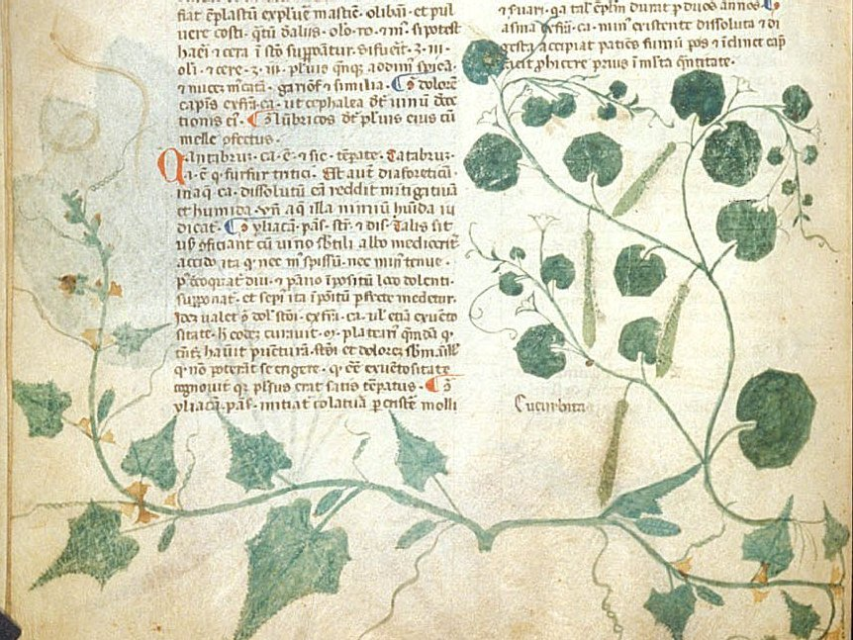
Tractatus de Herbis, 1300
Notes:
First picture of cucumber in Europe. The plant at the left, is cucumber, Cucumis sativus. The plant at the right, labelled Cucurbita, is bottle gourd, Lagenaria siceraria.

Slide 3
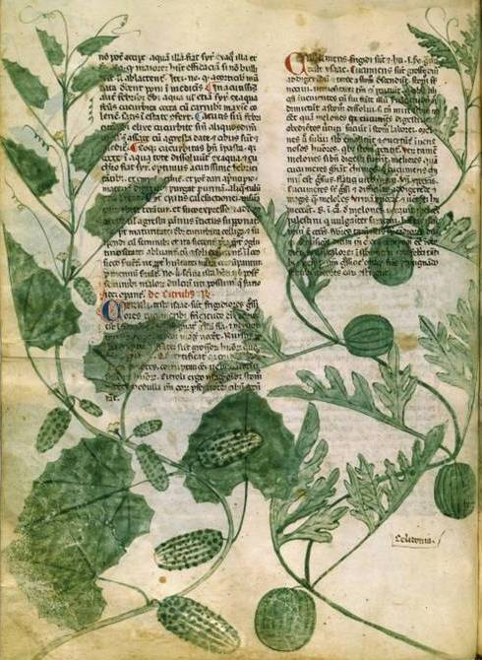
De Herbis, de Avibus et Piscibus, Manfred Manuscript of Pisa, Italy, 1330–1340
Notes:
Plant on left labeled citruli is cucumber, plant on right labeled cucumeris is watermelon

Slide 4
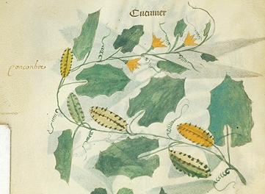
Tractatus de Herbis, 1375
Notes:
Plant labelled Cucumer is cucumber

Slide 5
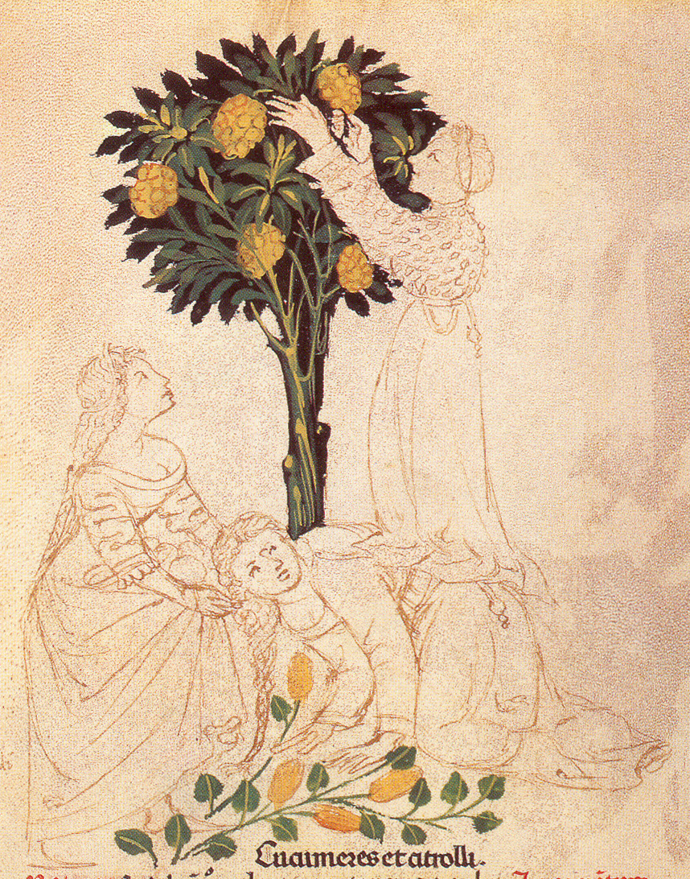
Tacuinum Sanitatum, Liege 1041, 1380–1400
Notes:
Italian Illustrated manual of Ibn Butlan from Iraq written in 11th century called Tables of Health. Note that cucumber labeled cucumeres is shown next to Citron tree (Citrus medica) labeled citroli give rise to the name citrullus for cucumber because bumpy skin was clos. Fruit resembles normal slicing type, yellow color might indicate mature.

Slide 6
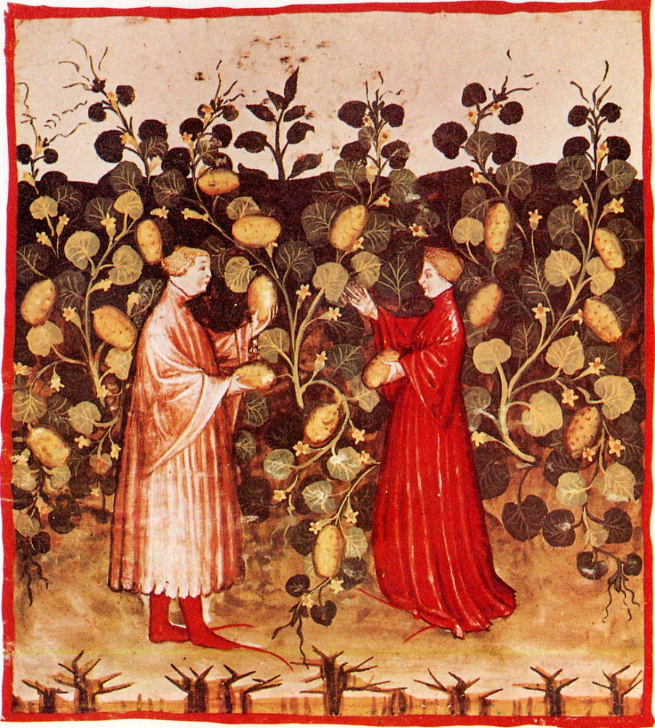
Tacuinum Sanitatum, Vienna 2644, 1390–1400
Notes:
Fat yellow (mature) cucumber, from Tacuinum Sanitatis. Close up shows warty skin

Slide 7
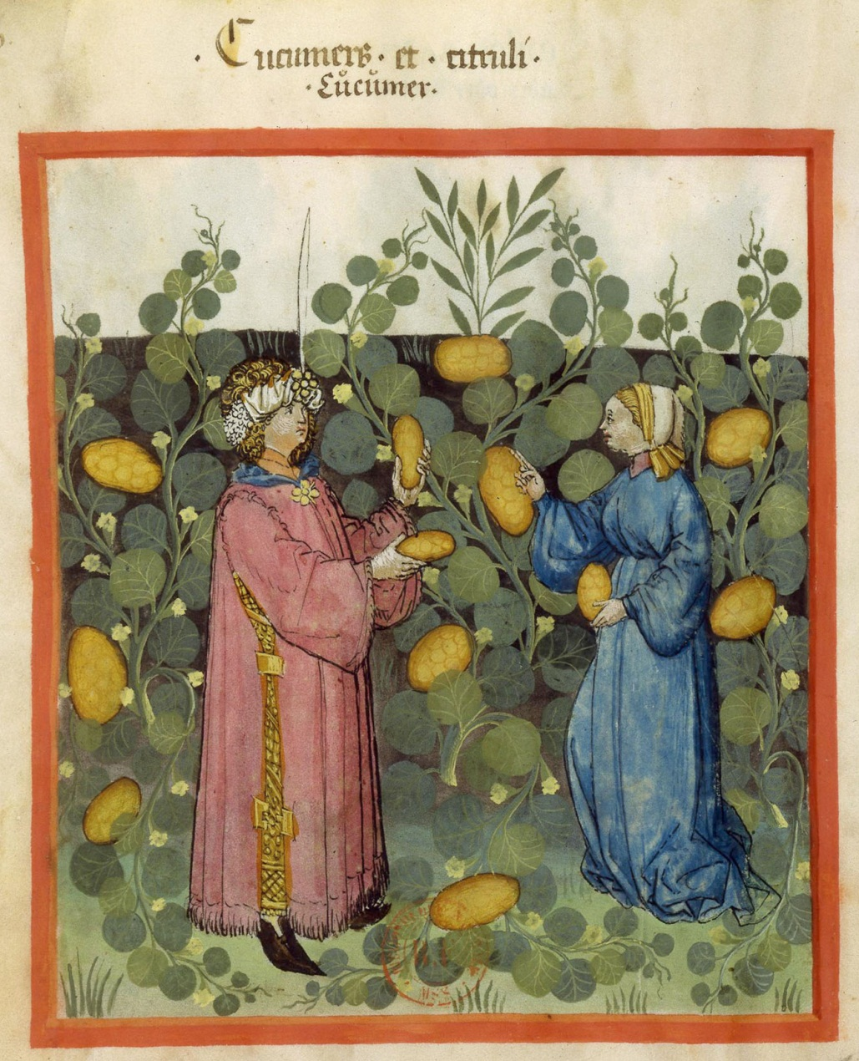
Tacuinum Sanitatum, Paris 9333, 1445–1451
Notes:
Copy of Tacuinum Sanitatis. Fat ripe fruit. Close up shows warty skin

Slide 8
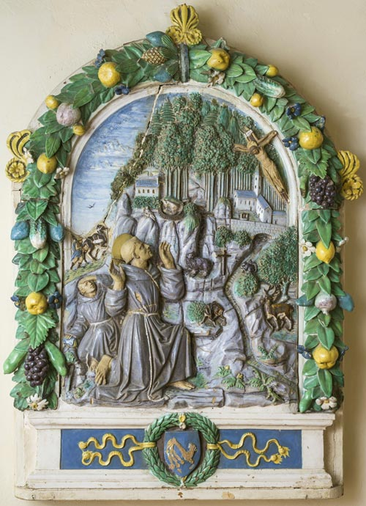
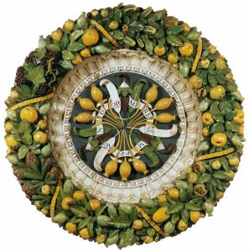
Della Robbia, 15th century
Notes:
Famous ceramicist Luca della Robbia from Florence often show cucumber in frames. Note the white tip and stripes.

Slide 9
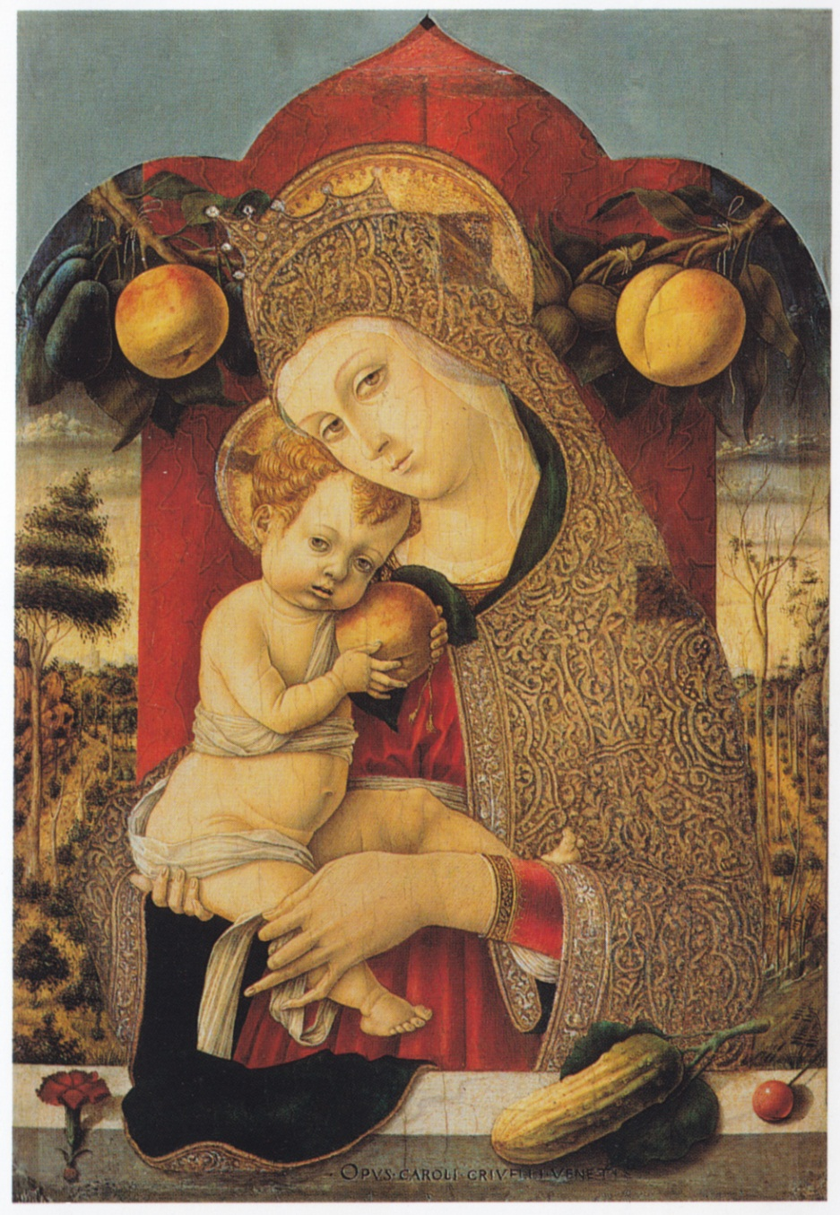
Carlo Crivelli, 1480
Notes:
Carlo Crivelli, Venetian Renaissance painter often painted fruits in connection with the Virgin Mary with prominent image of large cucumber of pickling type, very warty. This obviously phallic symbol of perdition is assumed to indicate that Mary was without sin.

Slide 10
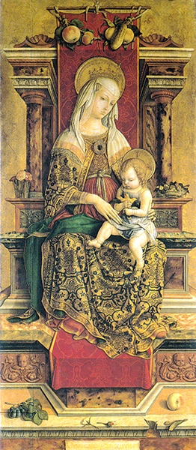
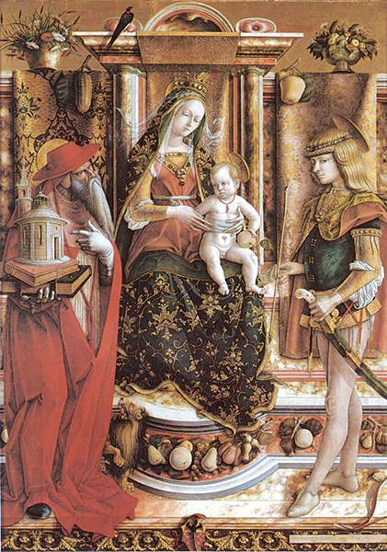
Carlo Crivelli, 1482, 1490

Slide 11
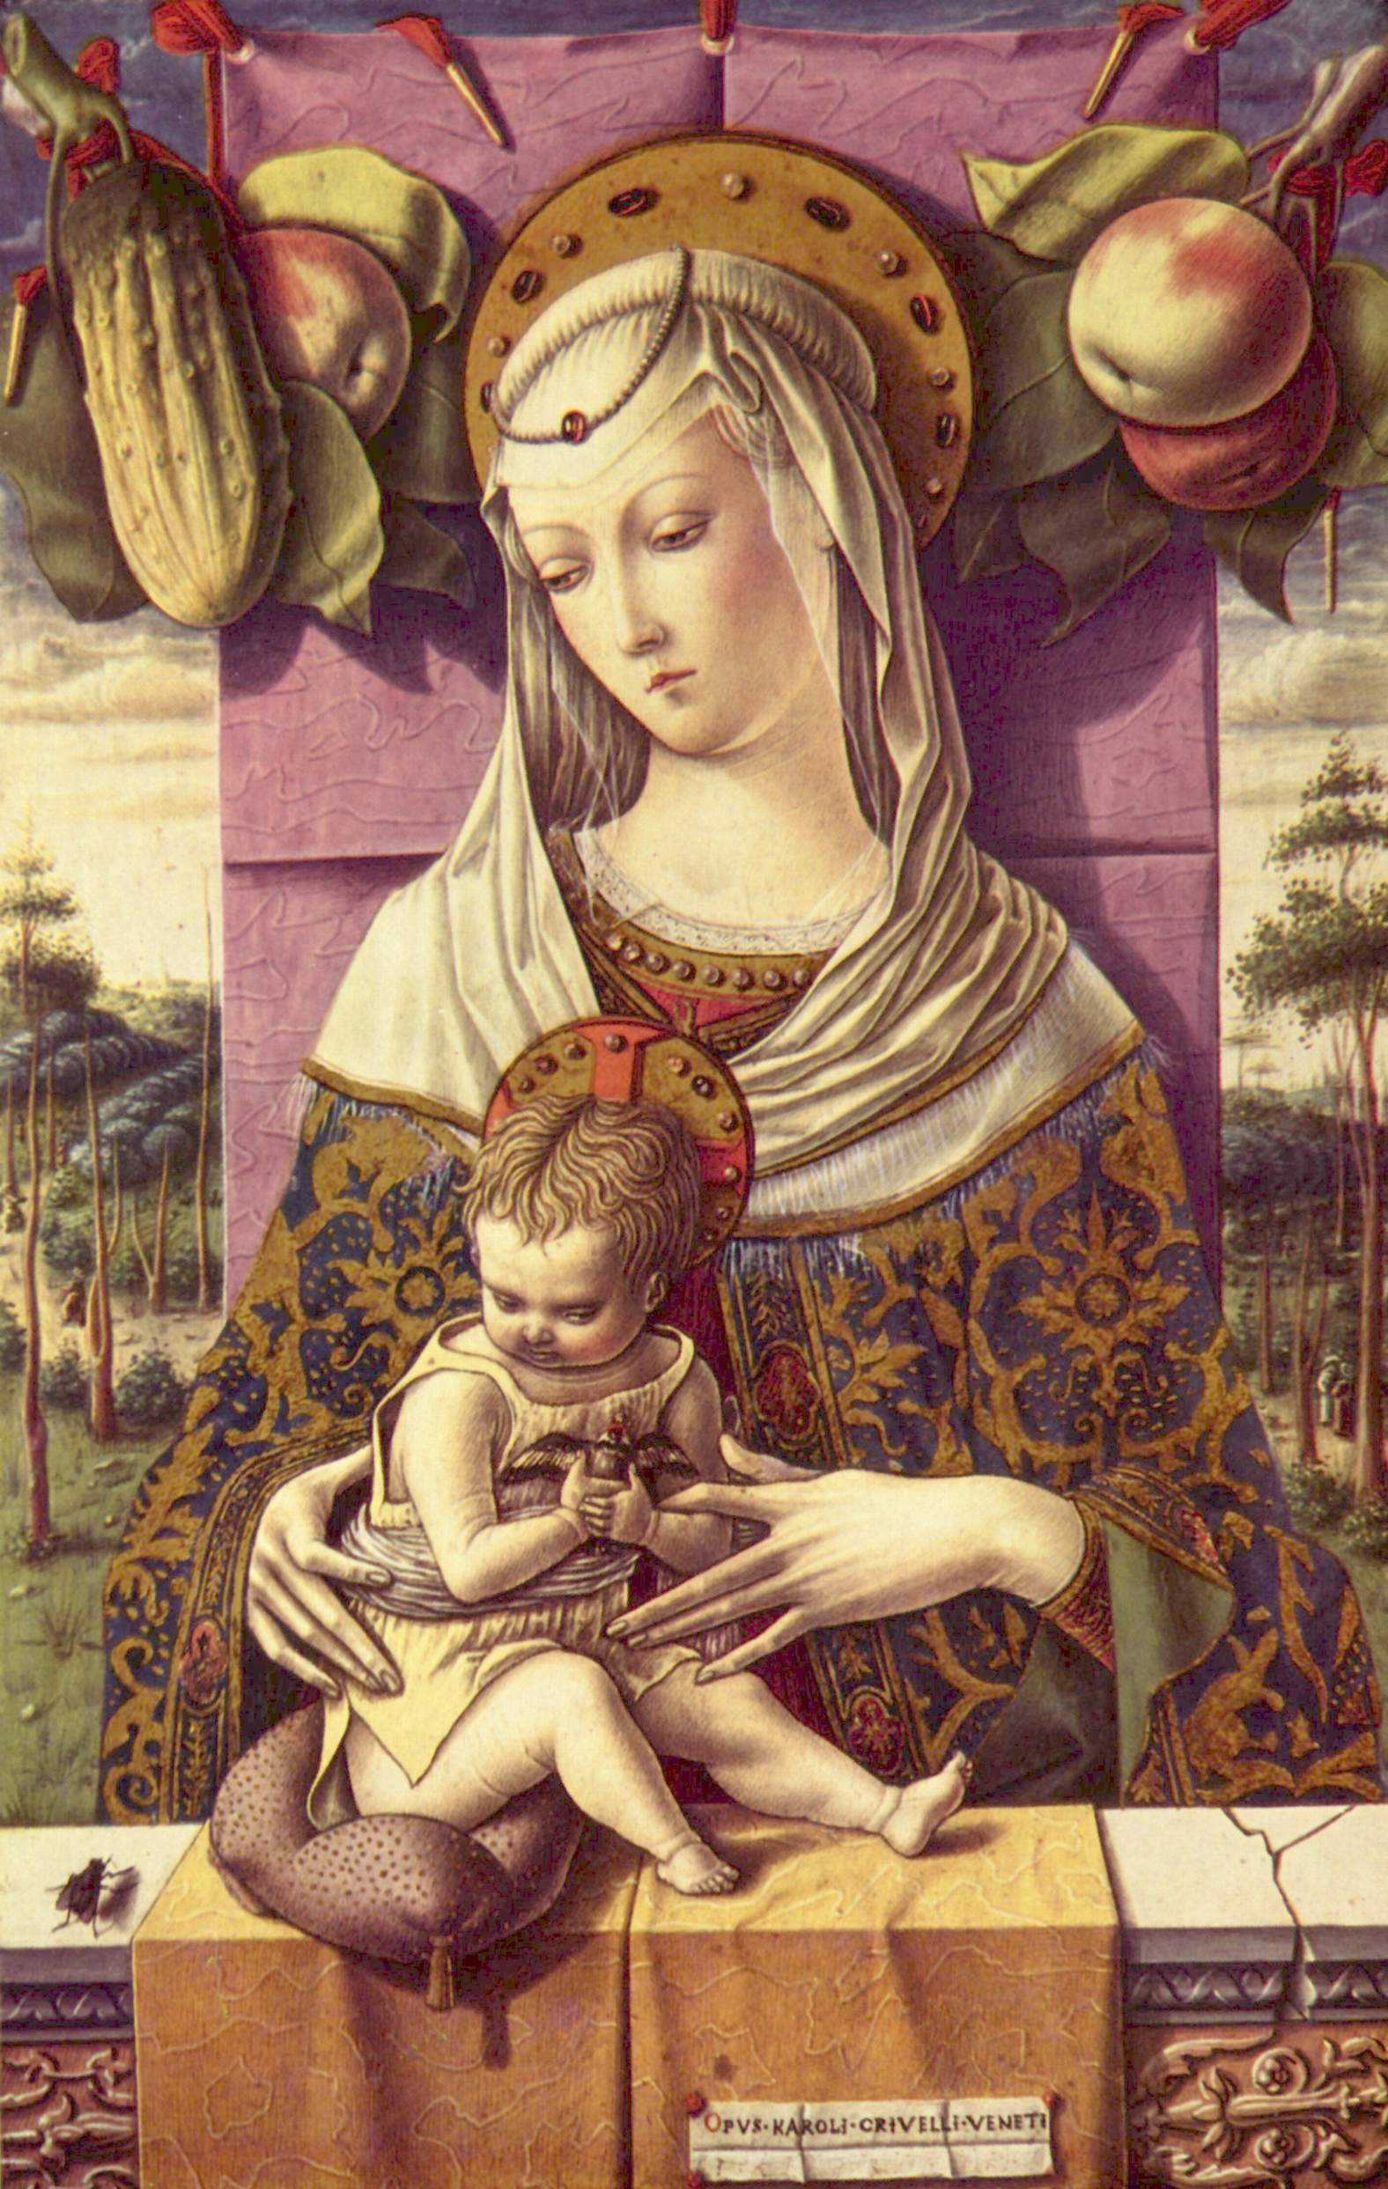
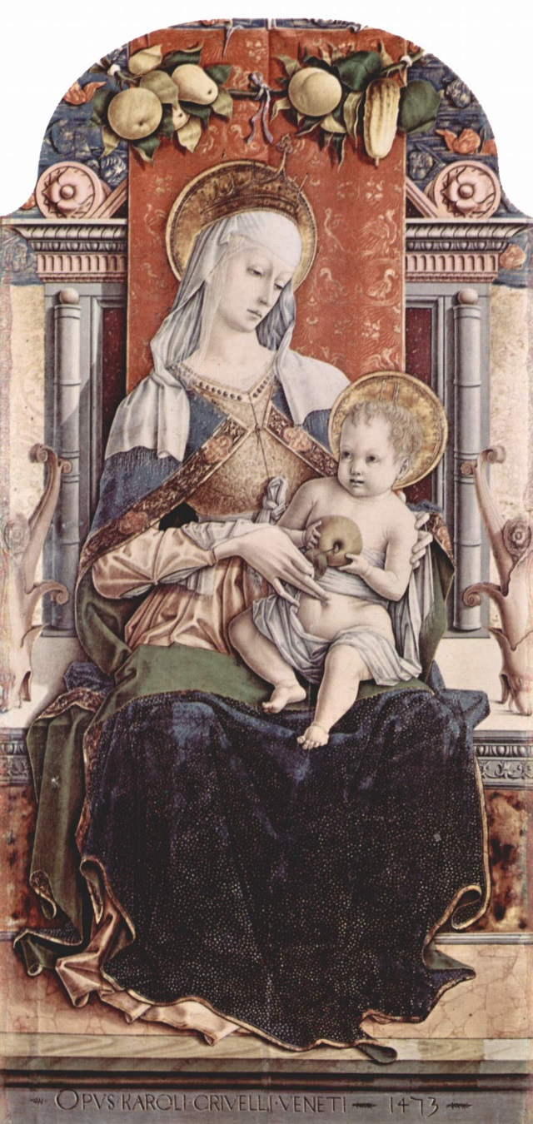
Carlo Crivelli, 1473

Slide 12
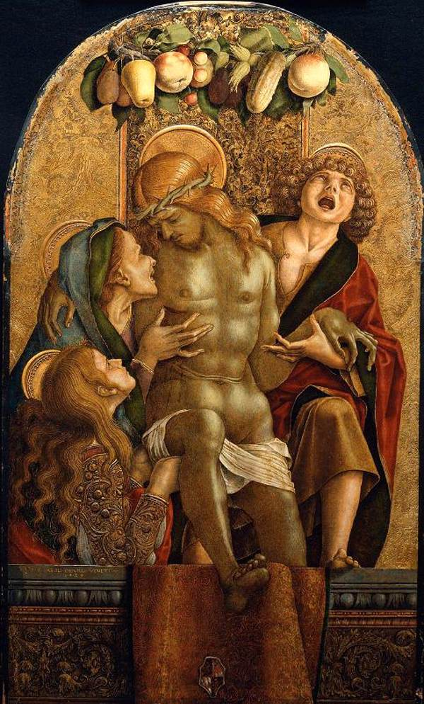
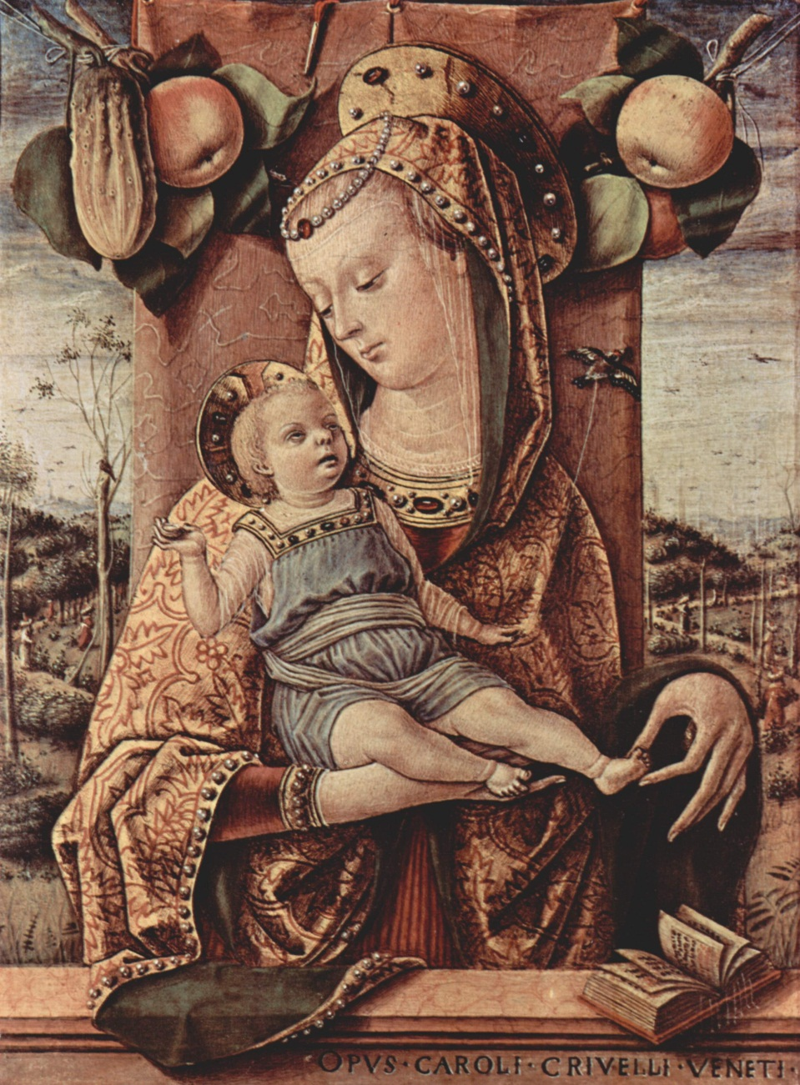
Carlo Crivelli, 1485, 1486

Slide 13
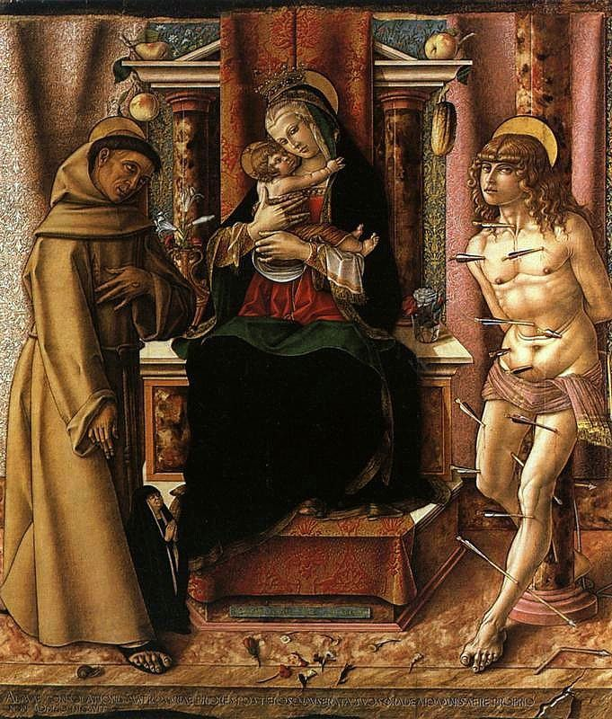
Carlo Crivelli, 1491

Slide 14
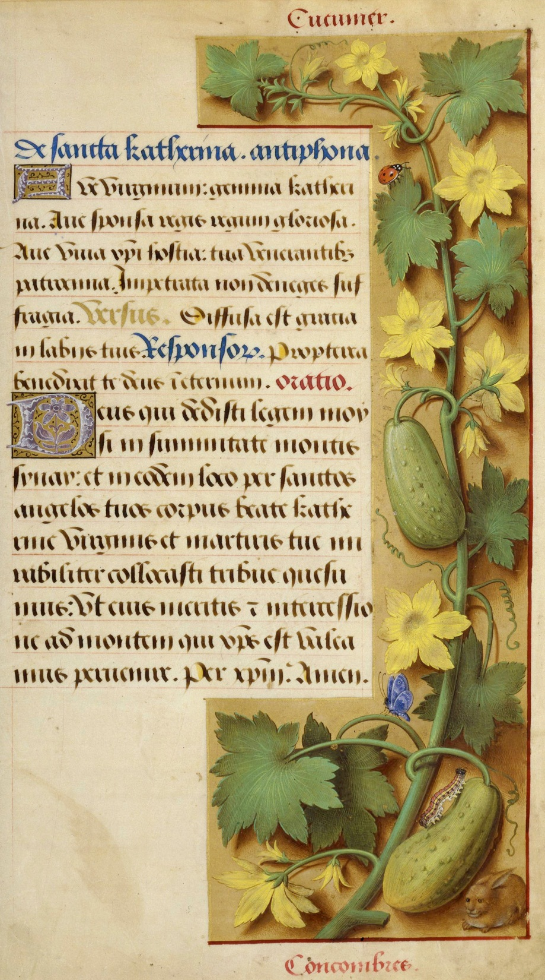
Jean Bourdichon 1505
Notes:
Prayer book called Hours of Anne of Britany is illustrated with about 500 plants by court artist Jean Bourdichon, famous miniaturist. Note the insects on cucumber.

Slide 15
Giovanni Martini da Udina Loggia of Cupid and Psyche, 1517
Notes:
Ceiling of Farnesina, Palace (Loggia of Cupid and Psyche) in Rome and show much variation. Painted by Giovanni Martini da Udina, workshop of Raphael Sanzio, next to Michelangelo the most famous Renaissance painter. There appear to be white and black spine cucumbers. Note color variation and maturity

Slide 16
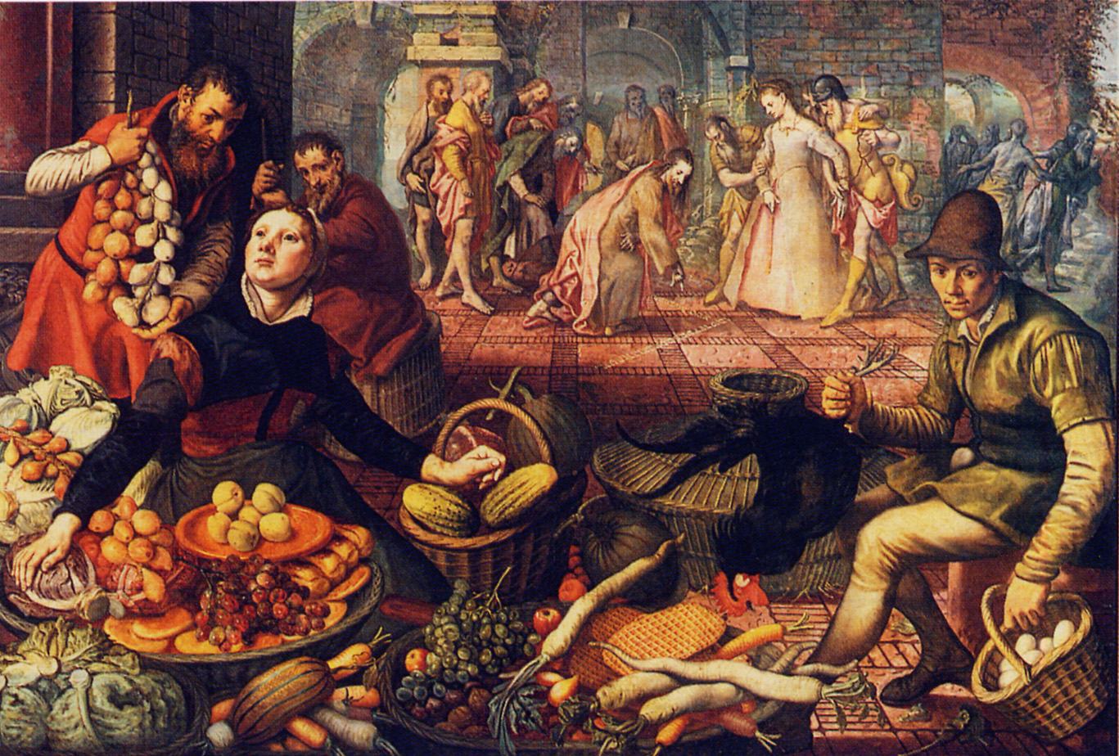
Pieter Aertsen, 1557–1558
Notes:
Flemish artist, note cucumber in basket. Note Belgium waffles!!

Slide 17
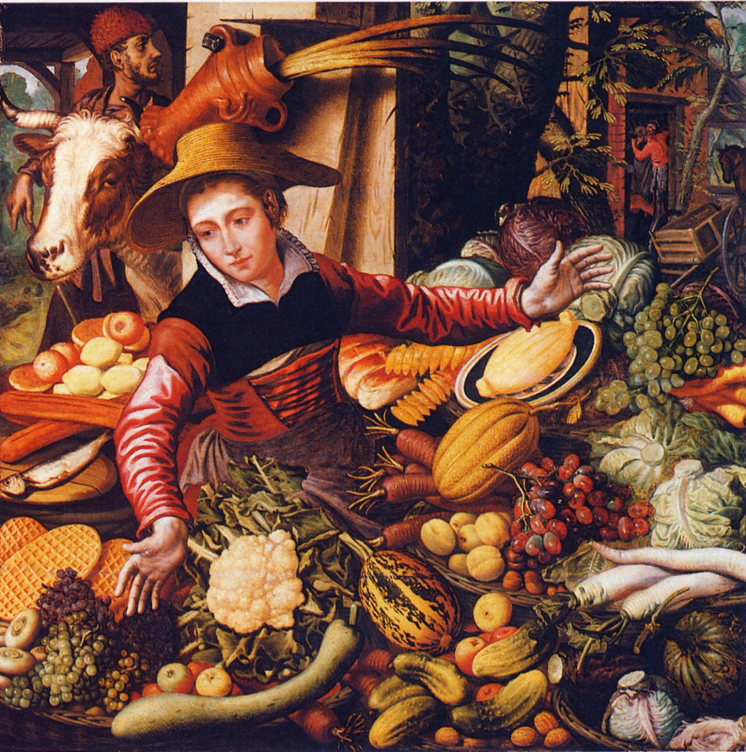
Pieter Aertsen, 1567
Notes:
Similar cucumber type.

Slide 18
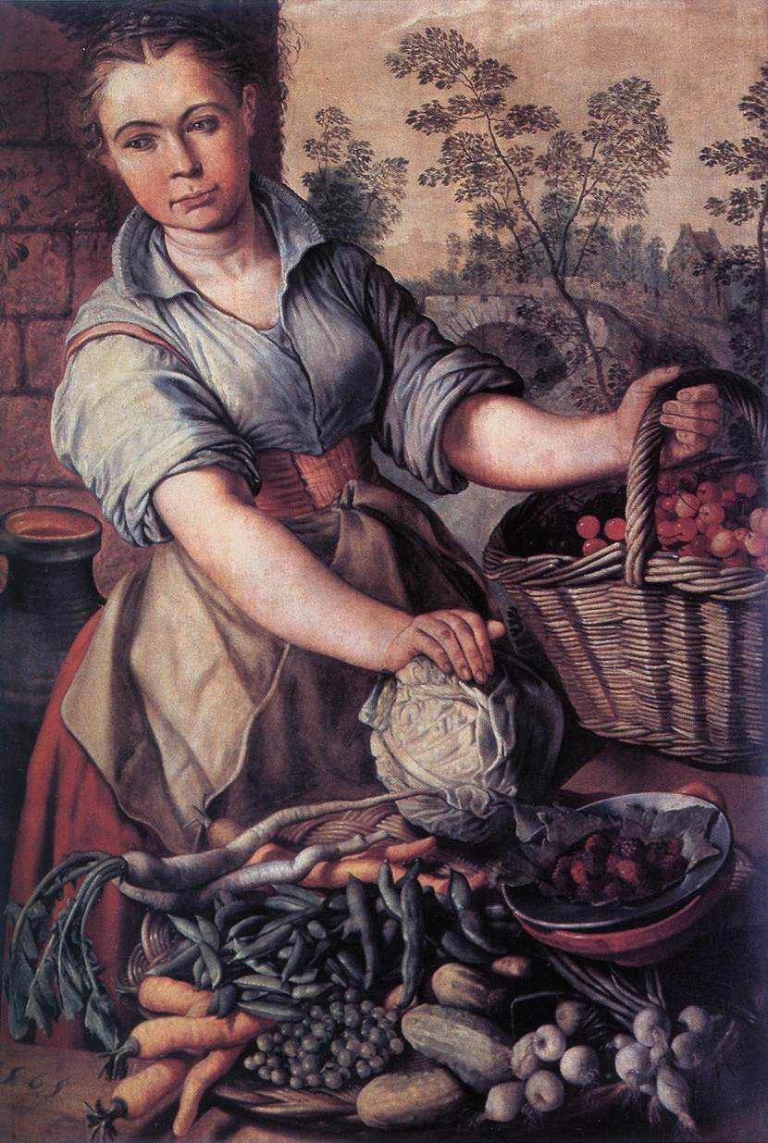
Joachim Beukelaer, 1533–1574
Notes:
Note same type of cucumber as Aertsen

Slide 19
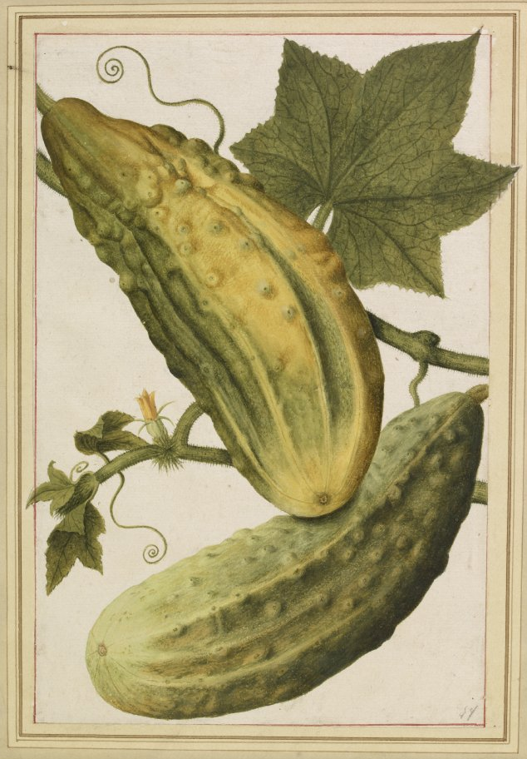
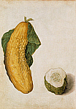
Jacques le Moyne de Morgues, ca. 1580
Notes:
Beautiful painting of Jacques Le Moyne …He also drew Indians and plants in Florida!

Slide 20
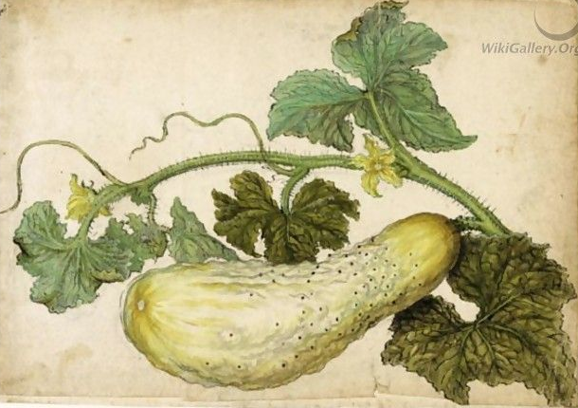
Jacques le Moyne de Morgues, ca. 1580
Notes:
Note fruit is black spined

Slide 21
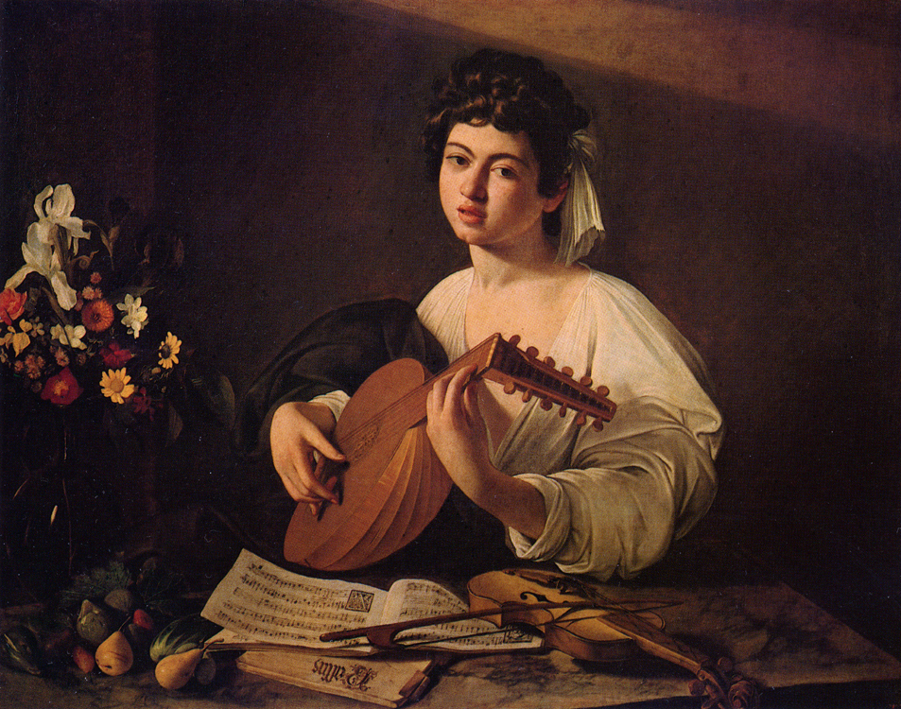
Caravaggio, 1595
Notes:
Cucumber is bottom of picture painted by young Caravaggio, one of the most famous baroque artists.

Slide 22
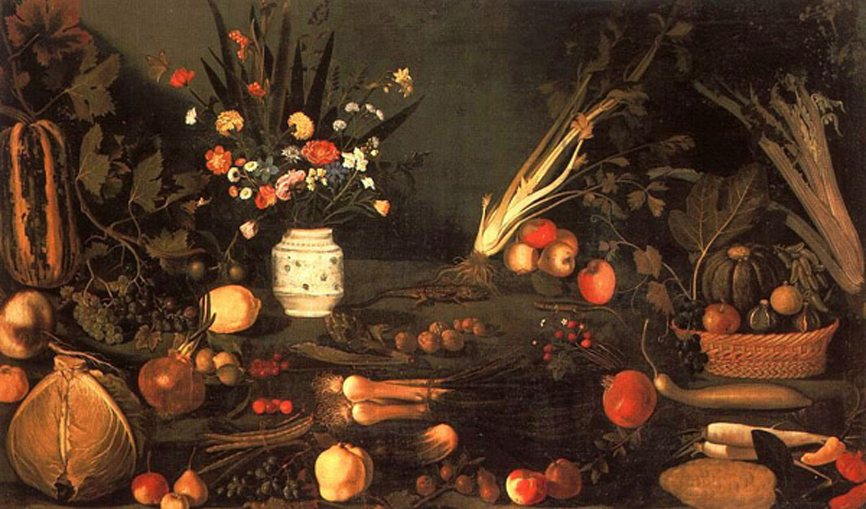
Master of Hartford, 1601
Notes:
Note the same type of cucumber as in previous Caravaggio painting. The Master of Hartford is assumed by some to be Caravaggio and the cuke lends support to this assumption.

Slide 23
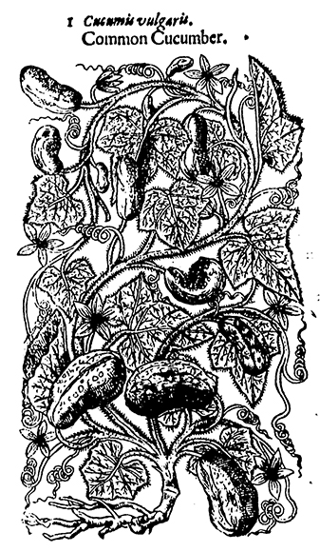
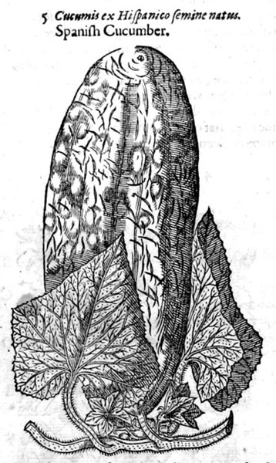
John Gerard 1597
Notes:
From John Gerard’s Herball but woodcuts were imported and are from Eicones Plantarum seu stirpium of Jacob Dietrich (known as Tabernaemontus), German herbalist.

Slide 24
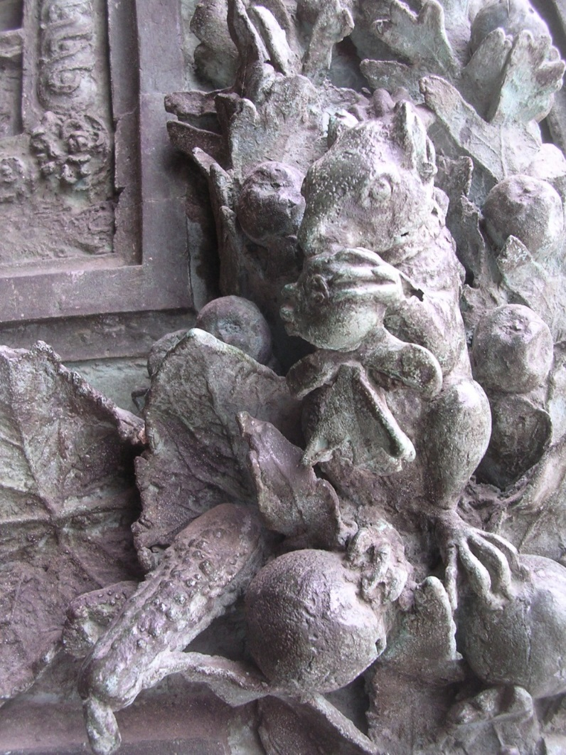
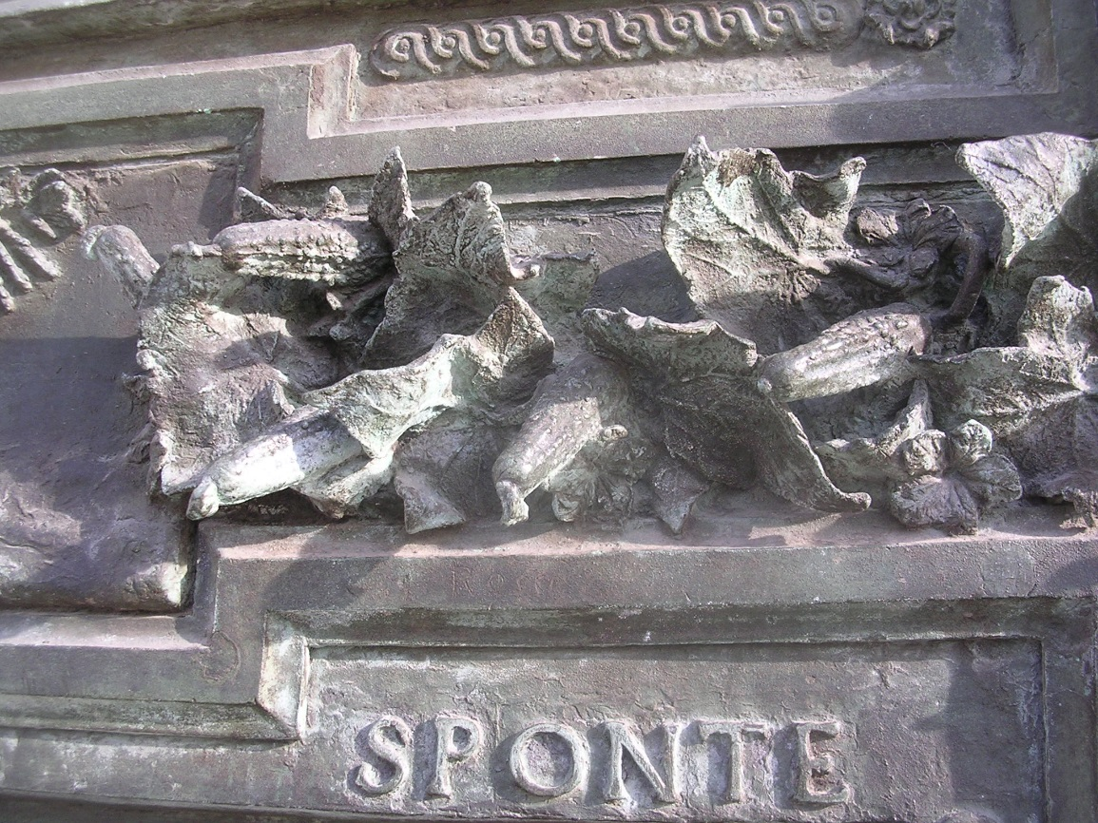
Pisa Cathedral, 1601
Notes:
Picture taken by Janick at the Cathedral doors in Pisa,

Slide 25
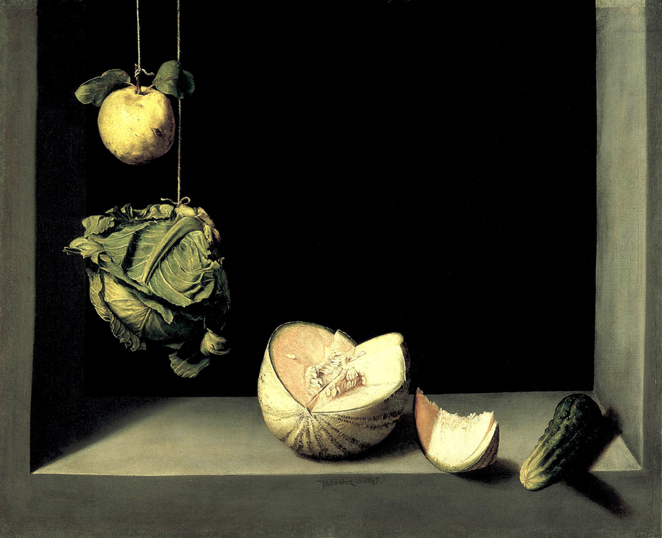
Juan Sánchez Cotán, <1603
Notes:
Most famous painting of Cotan, who joined a monastery and devoted the rest of his career to religious paintings, considered inferior to his horticultural works.

Slide 26
Nathaniel Bacon, 1620–1625
Notes:
Mature and immature cucumbers in basket. Note other cucurbit fruits.

Slide 27
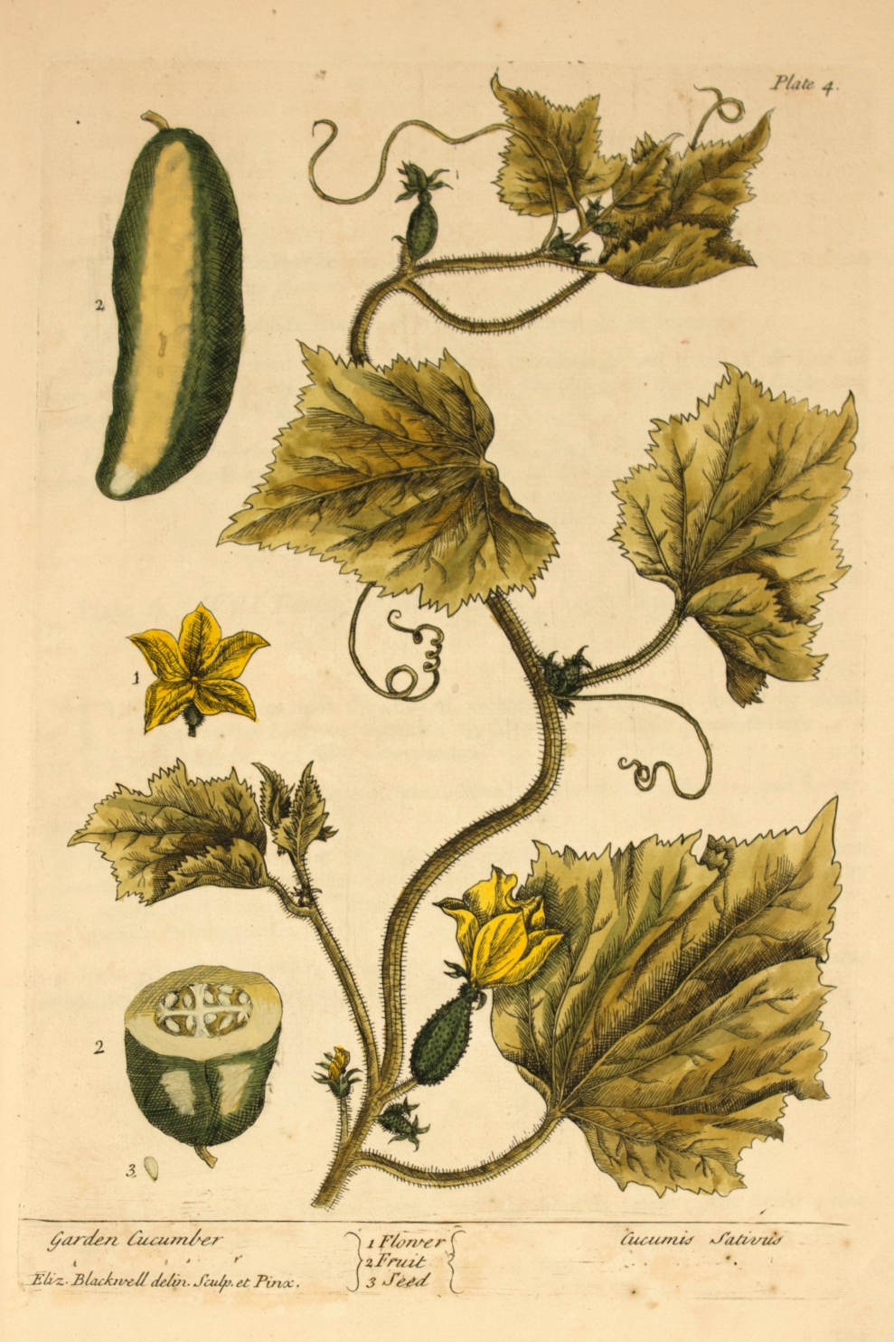
Elizabeth Blackwell, 1737
Notes:
Botanical drawing but seed attachment incorrect

Slide 28
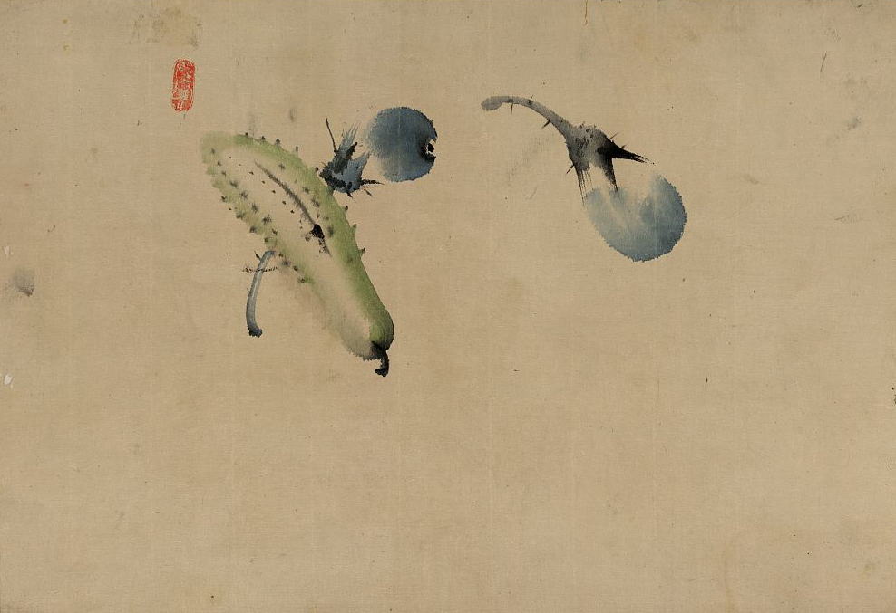
Katsushika Hokusai, 1790
Notes:
Japanese cucumber with rare wart pattern

Slide 29
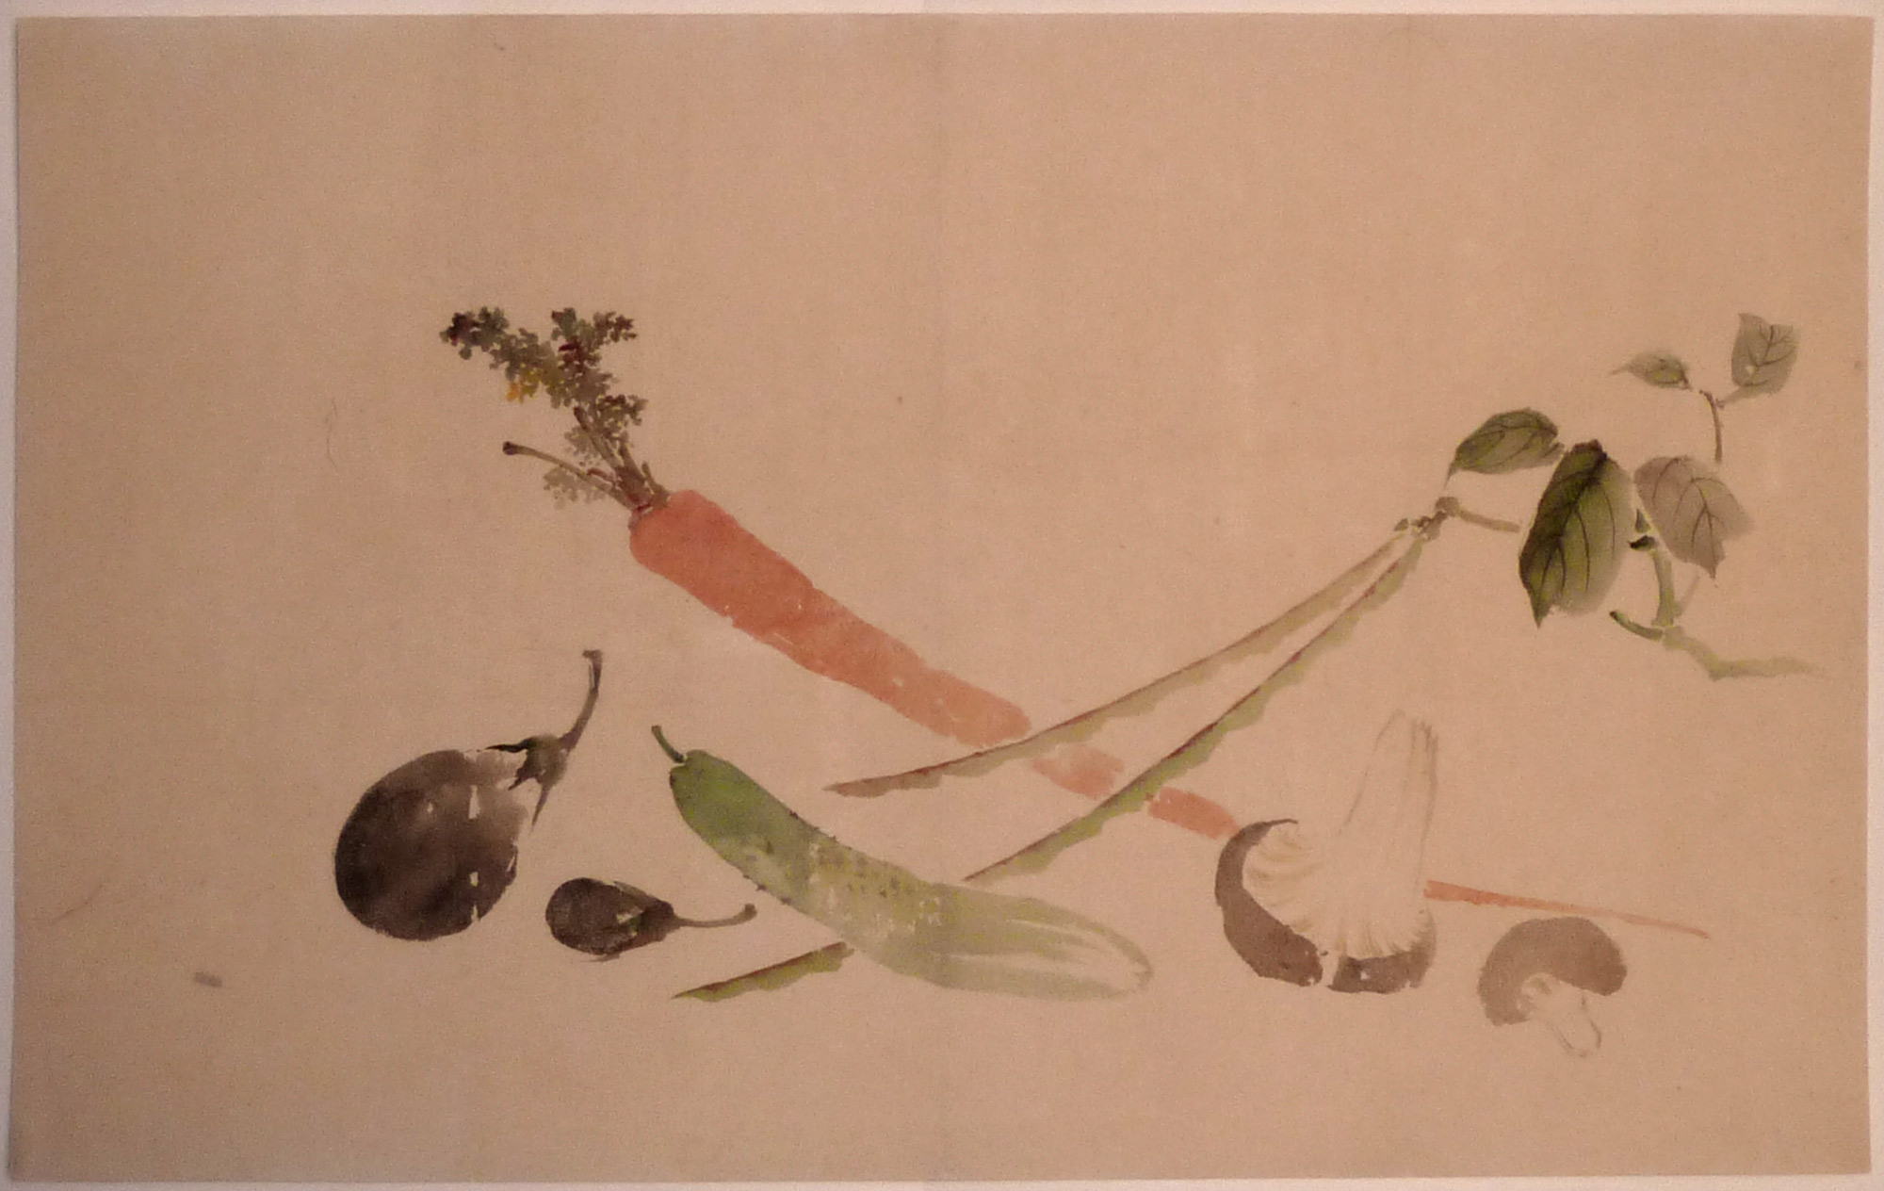
Katsushika Hokusai, 1760–1849
Notes:
Long Japanese cucumber

Slide 30
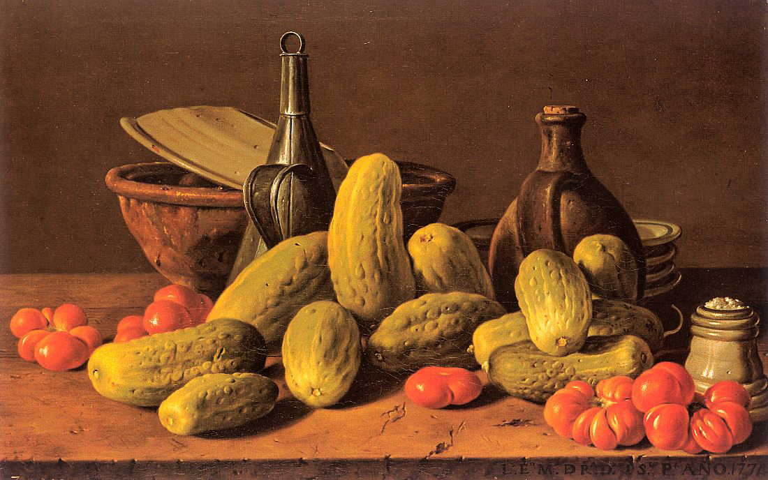
Luis Melendez, 1772
Notes:
Pickling types with a nearly square or blunt end.

Slide 31
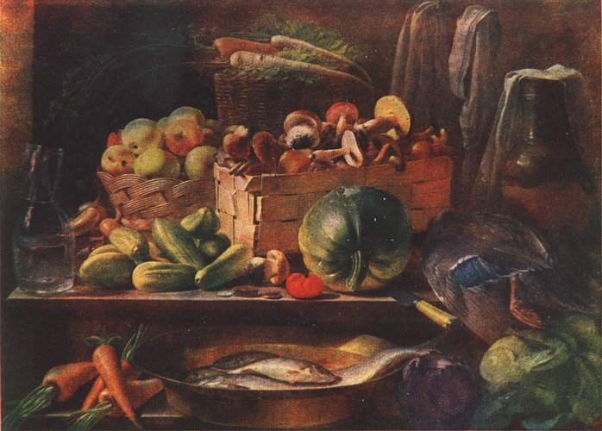
Ivan Xrutski, 1839
Notes:
Russian still lifes often have cucumber

Slide 32
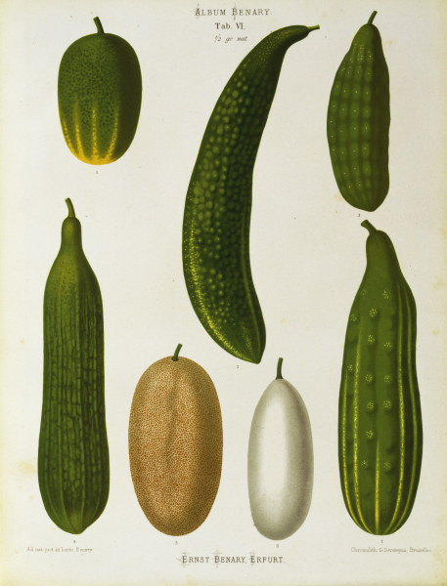
Album Benary, 1876
Early Short Green Russian
Longest Green Improved
Middle-sized Green
Athens, or Long Green Grecian
Khiva, Netted
Short White
Long Green Chinese
Notes:
Plate from the Album Benary based on a famous Jewish German Seedsman. The cucumbers are named (in English as follows). (1) Early Short Green Russian, see 48; Longest Green Improved, (3) Middle-sized Green (4) Athens or Long Green Grecian, (5) Khiva netted, (6). Short White for pickling, (7) Long Green Chinese. Note wide diversity.

Slide 33
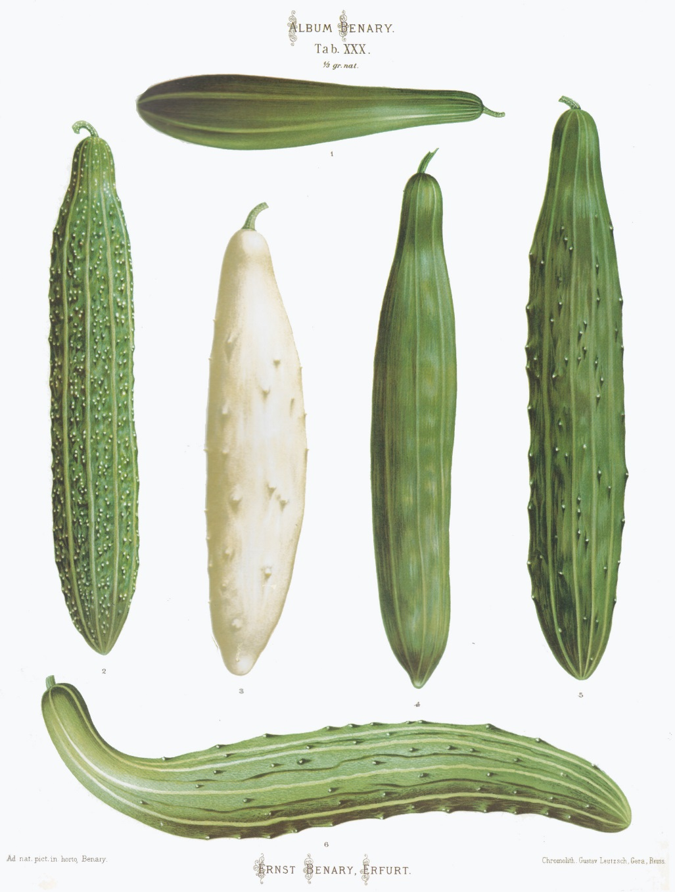
Album Benary, 1876
Sutton’s Cluster
“Frame cucumbers”
Duke of Edinburgh
White-spined, Small-leaved
Glory of Erfurt
Rollison’s Telegraph
Noa’s Forcing
Notes:
Trellised cucumber types

Slide 34
Denaiffe and Sons, 1909
Notes:
Wide diversity of cucumbers in French Seedsman brochure. Note that #7, serpent, is not a cucumber but a snake melon (Cucumis melo).

Slide 35
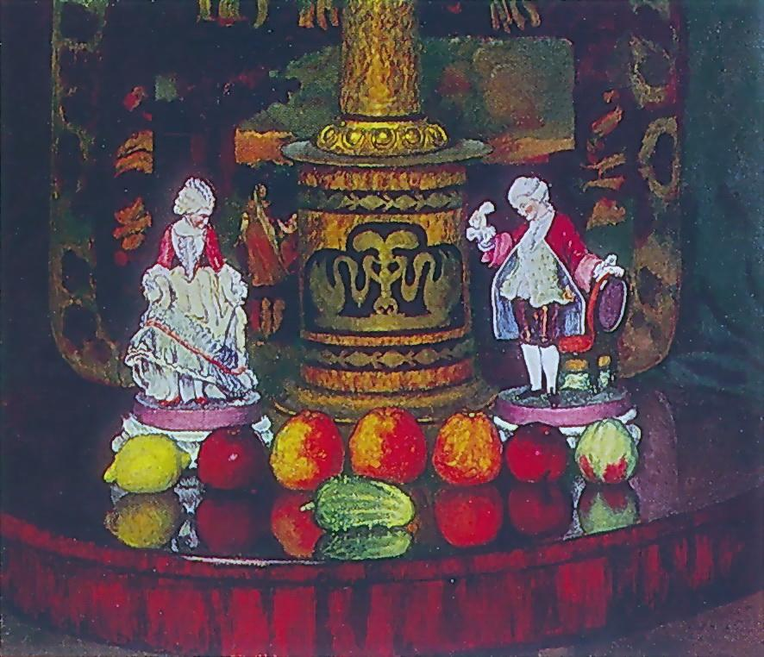
Ivan Mashkov, 1922
Notes:
Very squat type identified as an old Russian cultivar called the ‘Myromsck’ cucumber from a town called Myrom.

Slide 36
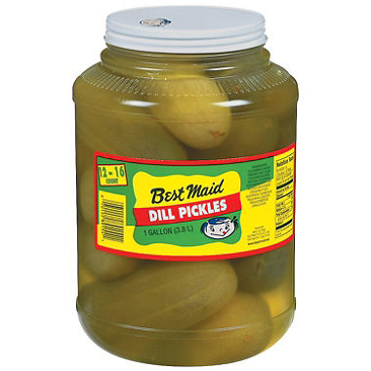
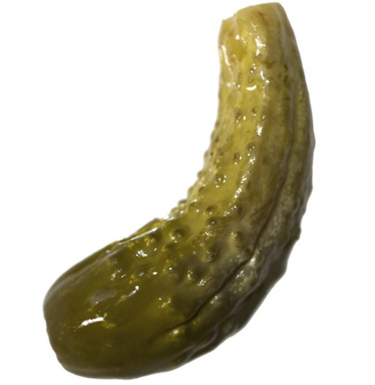
Notes:
The pickling type of cucumber so prevalent in early European paintings is still common, and the major type for the famous dill pickle.

