Slide 1
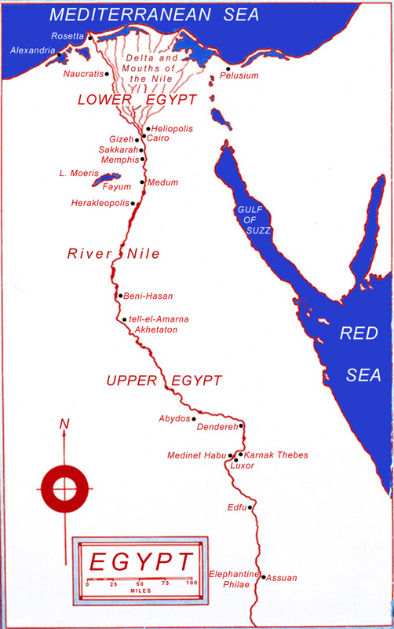
Ancient Egyptian Agriculture and the Origins of Horticulture
Jules Janick

Slide 2
Period | Time frame | Event
Paleolithic-Neolithic (Pre-dynastic) | 10,000–4000 BCE | Agricultural beginnings
Old Kingdom (I–VI dynasty) | 3100–2180 | Government; Earliest pyramids; Reunification of Upper and Lower Egypt (3100 BCE); King Zoser (2860 BCE); Inhotep, physician (2860 BCE)
Middle Kingdom (XI–XIV) | 2375–1800
Empire, New Kingdom (XVIII–XX) | 1570–1192 | Queen Hatsepsut (1490 BCE); death of Ikhnaton (1371 BCE); King Tut-Ankh-Amon (1343 BCE); Rameses II (1290 BCE); Moses (ca. 1200 BCE)
Saite, Late Period (XXVI) | 661–525
Persian | 525–332 (interrupted) | Death of Darius I of Persia (486)
Graeco-Roman | 332–30 | Alexander (332–323); Ptolemies, 14 Kings (323–30 BCE); Rosetta Stone inscribed (197 BCE); Cleopatra (51–30 BCE)
Byzantine | 305–642 CE
Arabic | 642–1517
Turkish | 1517–1804 | Rosetta Stone discovered (1779)
Modern | 1804–present | Mohamed Aly dynasty (1804–1952); Republic (1952–present)

Slide 3
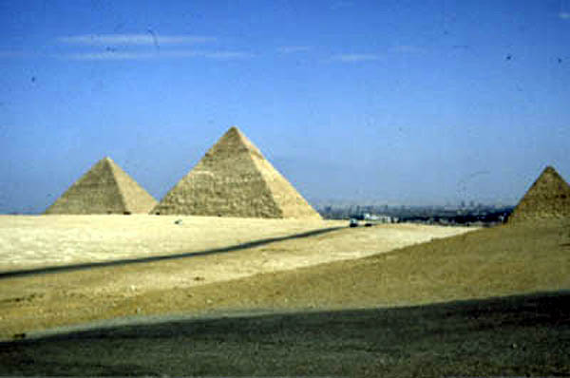
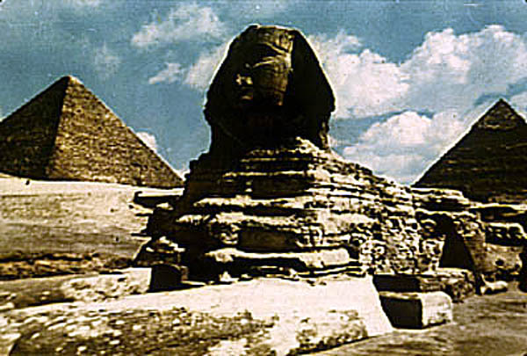
Pyramids at Giza
The great sphinx and pyramids at Giza

Slide 4
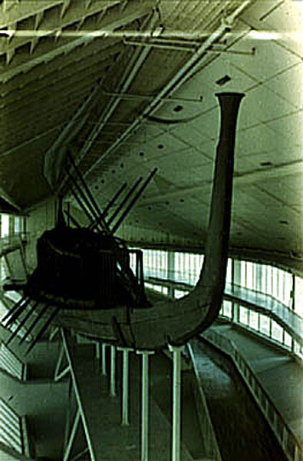
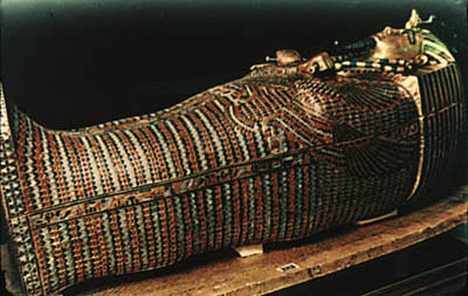
The sarcophagus of King Tut Ankh Amun
encrusted with gold and semiprecious stones
The Sun Boat Model in the Special Museum at Giza

Slide 5
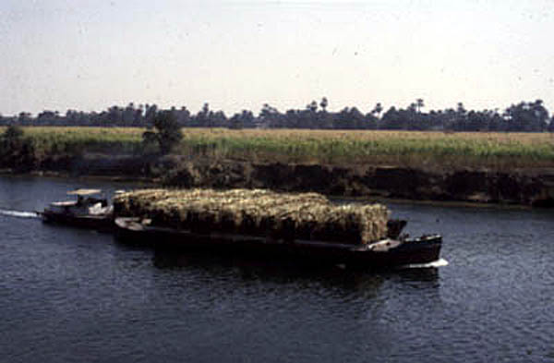
A barge carrying agricultural products in the Nile Egypt is the gift of the Nile (Herodotus 484–425 BCE, Greek historian)
Source: J. Janick photo.

Slide 6
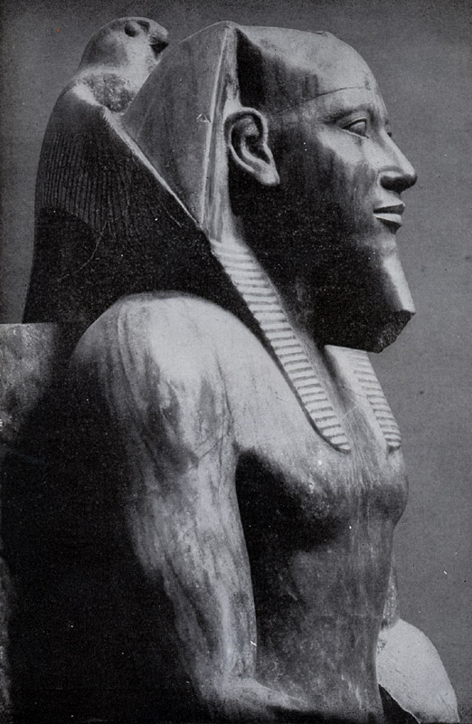
Diorite head of the Pharaoh Khafre 4th Dynasty Reigned 2558–2532 BCE
Source: Durant, Our Oriental Heritage.

Slide 7
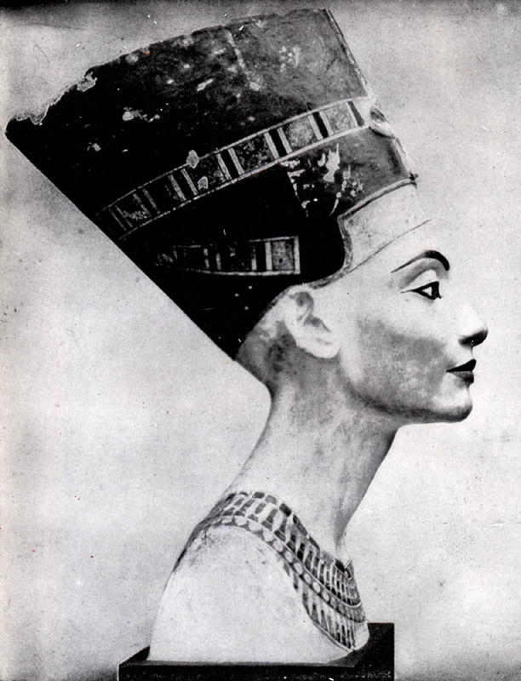
Painted limestone head of Ikhnaton’s Queen Nofretete ca. 1370–1330 BCE
Source: Durant, Our Oriental Heritage.

Slide 8
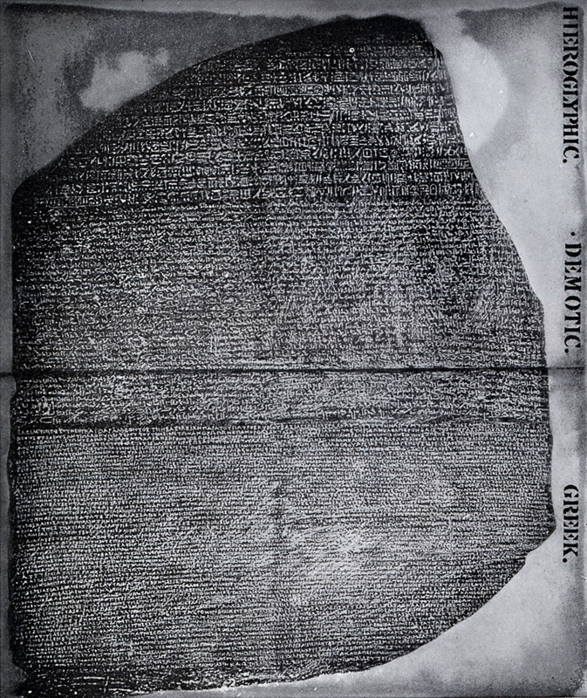
The Rosetta Stone
Source: Durant,
Our Oriental Heritage.

Slide 9
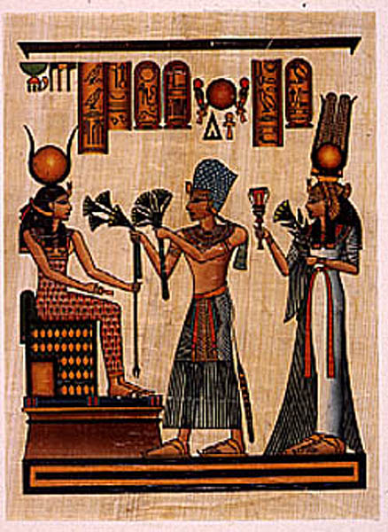
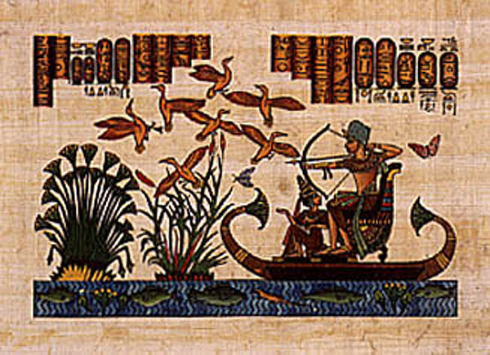
Plants as Symbols
Papyrus and lotus symbols of upper and lower Egypt
Hunting scene showing lotus and papyrus
Offering of lotus and papyrus to Isis

Slide 10
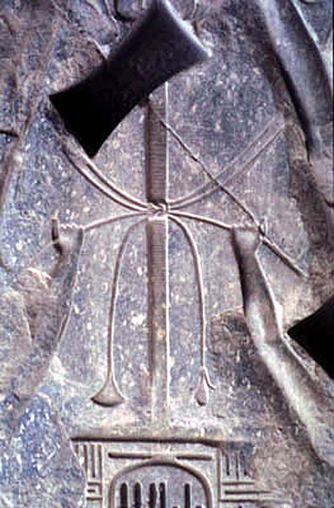
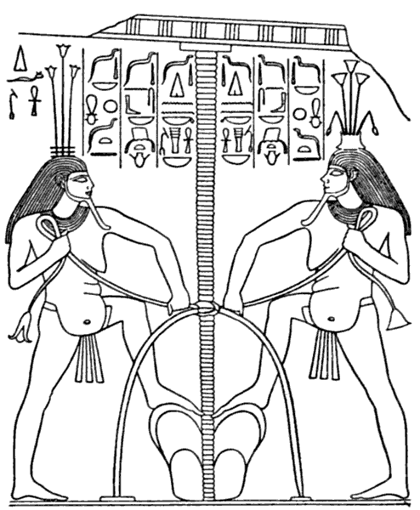
Intertwining of lotus and papyrus symbolizing the reunification of upper and lower Egypt
Source: Cairo museum, J. Janick photo
Source: Throne of Semuscret I. 1900 BCE, Singer et al., 1954

Slide 11
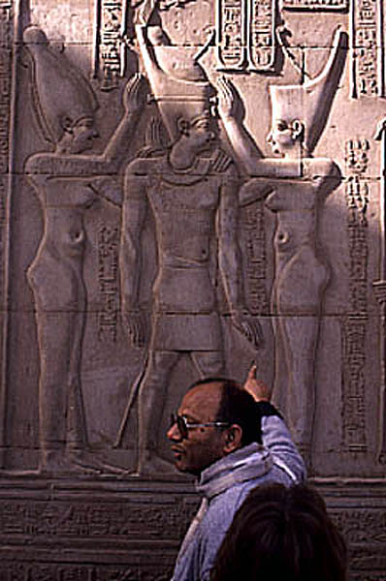
The unification of upper and lower Egypt was celebrated by the design of a new crown fusing the design of each
Source: J. Janick photo.

Slide 12
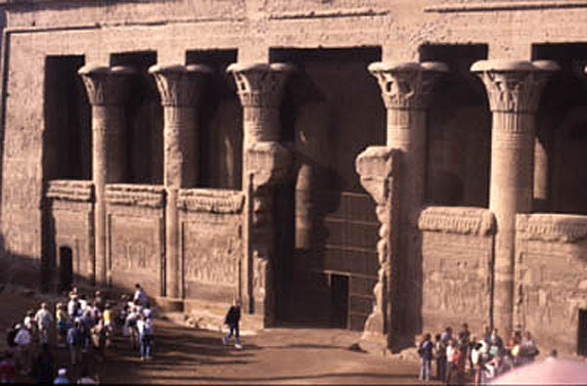
The Temple of Khnum (Kom Ombo), at Esna showing columns representing papyrus and lotus
Source: J. Janick photo

Slide 13
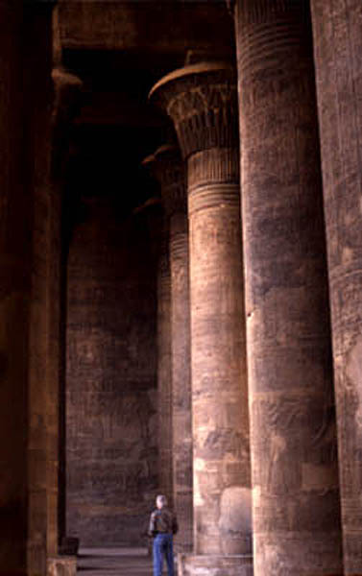
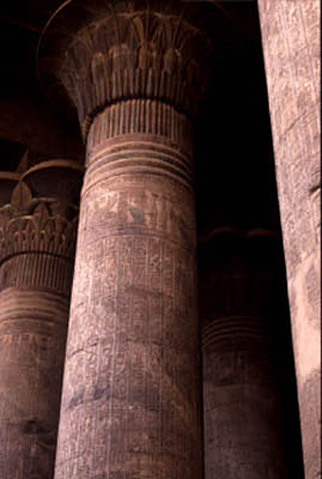
The Temple of Khnum (Kom Ombo), at Esna showing columns representing papyrus and lotus
Source: J. Janick photo

Slide 14
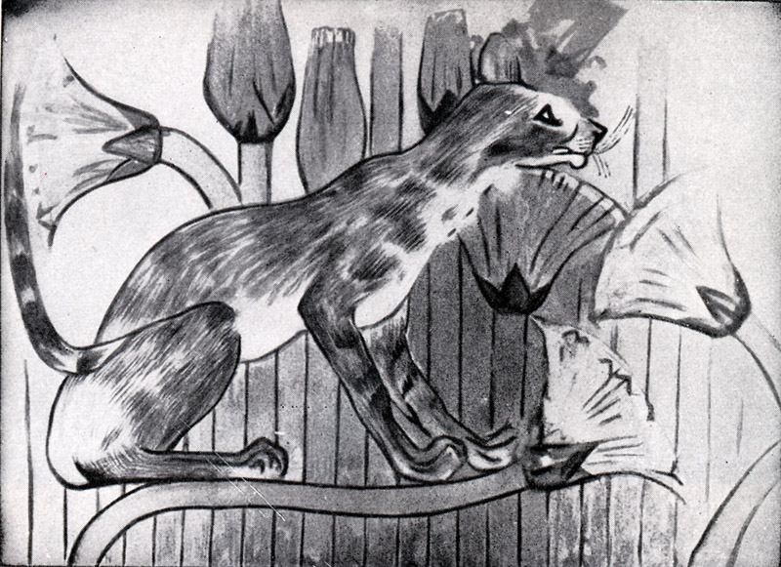
Cat watching his prey
A wall-painting in the grave of Khnumhotep at Beni-Hasan
Source: Durant, Our Oriental Heritage.

Slide 15
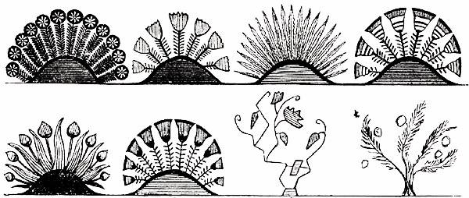
Different representations of plants
Source: Wilkinson, The Ancient Egyptians

Slide 16
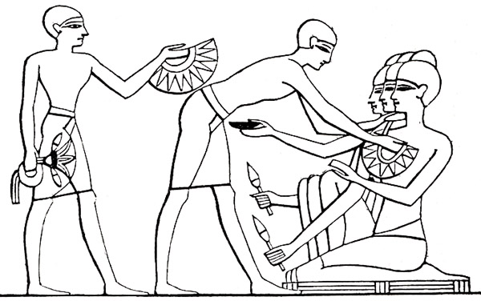
Servants bringing necklaces of flowers
Source: Wilkinson, The Ancient Egyptians

Slide 17
Egyptian Religion
Source: W. Durant
Profound, too, was the myth of Isis, the Great Mother.
She was not only the loyal sister and wife of Osiris; in a sense she was greater than he, for—like woman in general she had conquered death through love.
Nor was she merely the black soil of the Delta, fertilized by the touch of Osiris–Nile, and making all Egypt rich with her fecundity.
She was, above all, the symbol of that mysterious creative power which had produced the earth and every living thing, and of that maternal tenderness whereby, at whatever cost to the mother, the young new life is nurtured to maturity.

Slide 18
She represented in Egypt—as Kali, Ishtar and Cybele represented in Asia, Demeter in Greece, and Ceres in Rome—the original priority and independence of the female principle in creation and in inheritance, and the originative leadership of woman in tilling the earth; for it was Isis (said the myth) who had discovered wheat and barley growing wild in Egypt, and had revealed them to Osiris (man).

Slide 19
The Egyptians worshiped her with especial fondness and piety, and raised up jeweled images to her as the Mother of God; her tonsured priests praised her in sonorous matins and vespers; and in midwinter of each year, coincident with the annual rebirth of the sun towards the end of our December, the temples of her divine child, Horus (god of the sun), showed her, in holy effigy, nursing in a stable the babe that she had miraculously conceived.

Slide 20
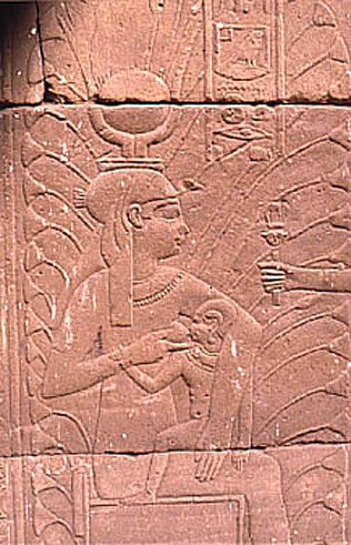
These poetic‑philosophic legends and symbols profoundly affected Christian ritual and theology.
Early Christians sometimes worshiped before the statues of Isis suckling the infant Horus, seeing in them another form of the ancient and noble myth by which woman (i.e., the female principle), creating all things, becomes at last the Mother of God.
Isis suckling her sun Horus, later depicted as a falcon-headed god.
Isis later became a cult figure and was worshiped as a female deity.
Egyptian theology has a strong influence on subsequent religious practices of Judaism, Christianity, and Islam.
Source: J. Janick photo.

Slide 21
Agriculture
Source: W. Durant
Behind these kings and queens were pawns; behind these temples, palaces and pyramids were the workers of the cities and peasants of the fields.
The population of Egypt in the fourth century before Christ is estimated at some 7,000,000 souls.
Herodotus describes them optimistically as he found them about 450 BCE:

Slide 22
They gather in the fruits of the earth with less labor than any other people, … for they have not the toil of breaking up the furrow with the plough, nor of hoeing, nor of any other work which all other men must labor at to obtain a crop of corn; but when the river has come of its own accord and irrigated their fields, and having irrigated them has subsided, then each man sows his own land and turns his swine into it; and when the seed has been trodden into it by the swine he waits for harvest time; then … he gathers it in.

Slide 23
As the swine trod in the seed, so apes were tamed and taught to pluck fruit from the trees.
And the same Nile that irrigated the fields deposited upon them, in its inundation, thousands of fish in shallow pools; even the same net with which the peasant fished during the day was used around his head at night as a double protection against mosquitoes.
Nevertheless it was not he who profited by the bounty of the river.
Every acre of the soil belonged to the Pharaoh, and other men could use it only by his kind indulgence; every tiller of the earth had to pay him an annual tax of ten or twenty percent in kind.

Slide 24
Large tracts were owned by the feudal barons or other wealthy men; the size of some of these estates may be judged from the circumstance that one of them had 1500 cows. Cereals, fish and meat were the chief items of diet.
One fragment tells the school-boy what he is permitted to eat; it includes 33 forms of the flesh, 48 baked meats, and 24 varieties of drink.
The rich washed down their meals with wine, the poor with barley beer. The lot of the peasant was hard.
The “free” farmer was subject daily to the middleman and the tax-collector, who dealt with him on the most time-honored of economic principles, taking “all that the traffic would bear” out of the produce of the land.

Slide 25
Here is how a complacent contemporary scribe conceived the life of the men who fed ancient Egypt:
Dost thou not recall the picture of the farmer when the tenth of his grain is levied?
Worms have destroyed half the wheat, and the hippopotami have eaten the rest; there are swarms of rats in the fields, the grasshoppers alight there, the cattle devour, the little birds pilfer; and if the farmer loses sight for an instant of what remains on the ground, it is carried off by robbers; moreover, the thongs which bind the iron and the hoe are worn out, and the team has died at the plough.

Slide 26
It is then that the scribe steps out of the boat at the landing-place to levy the tithe, and there come the Keepers of the Doors of the (King’s) Granary with cudgels, and Negroes with ribs of palm-leaves, crying, “Come now, come!”
There is none, and they throw the cultivator full length upon the ground, bind him, drag him to the canal, and fling him in head first; his wife is bound with him, his children are put into chains. The neighbors in the meantime leave him and fly to save their grain.
It is a characteristic bit of literary exaggeration; but the author might have added that the peasant was subject at any time to the corvée, doing forced labor for the King, dredging the canals, building roads, tilling the royal lands, or dragging great stones and obelisks for pyramids, temples, and palaces.

Slide 27
Probably a majority of the laborers in the field were moderately content, accepting their poverty patiently.
Many of them were slaves, captured in the wars or bonded for debt; sometimes slave-raids were organized, and women and children from abroad were sold to the highest bidder at home.

Slide 28
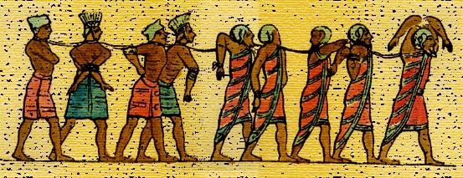
An old relief in the Leyden Museum pictures a long procession of Asiatic captives passing gloomily into the land of bondage: one sees them still alive on that vivid stone, their hands tied behind their backs or their heads, or thrust through rude handcuffs of wood; their faces empty with the apathy that has known the last despair.

Slide 29
Egyptian Grains
Barley
Wheat
Einkorn (AA)
Emmer (AABB)
Durum (AABB)
Spelt (AABBDD)
Bread (AABBDD)

Slide 30
Egyptian Vegetables
Alliums
garlic, onion
Cucurbits
melon, watermelon
Crucifers
radish
Lettuce
Parsley
Pulses (legume crops)
cowpea, fava bean,
chickpea, lentil

Slide 31
Common name of fruit crops | Scientific name | Earliest record | Evidence
Date palm | Phoenix dactylifera | Pre-dynastic | Archeological
Doum palm | Hyphaene thebaica | Pre-dynastic | Archeological
Sycomore fig | Ficus sycomorus | Pre-dynastic | Archeological
Jujube | Ziziphus spina-Christi | I (Old Kingdom) | Archeological
Fig | Ficus carica | II (Old Kingdom) | Artistic
Grape | Vitis vinifera | II (Old Kingdom) | Archeological
Hegelig | Balanites aegyptiaca | III (Old Kingdom) | Archeological
Persea (lebakh) | Mimusops shimperi | III (Old Kingdom) | Archeological
Argun palm | Medemia argun | V (Old Kingdom) | Archeological
Carob | Ceratonia siliqua | XII (Middle Kingdom) | Archeological
Pomegranate | Punica granatum | XII (Middle Kingdom) | Archeological
Egyptian plum | Cordia myxa | XVIII (New Kingdom) | Archeological
Olive | Olea europea | XVIII (New Kingdom) | Archeological
Apple | Malus ×domestica | XVIIII (New Kingdom) | Literary
Peach | Prunus persica | Graeco-Roman | Archeological
Pear | Pyrus communis | Graeco-Roman | Archeological
Cherry | Prunus avium; P. cerasus | 5 BCE | Literary
Citron | Citrus medica | 2nd century CE | Literary

Slide 32
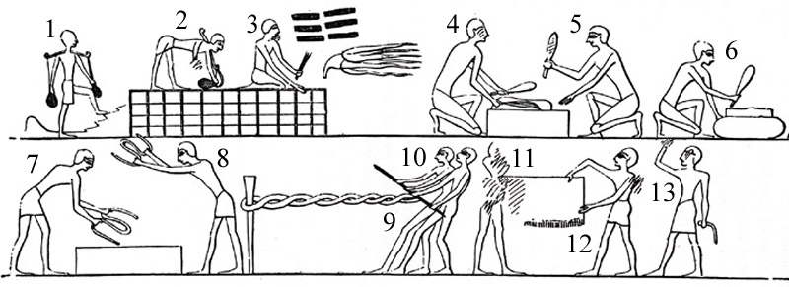
Preparing the flax, beating it, and making it into twine and cloth
1 Brings water in earthen pots
4,5 Engaged in beating it with mallets
7,8 Striking it, after it is made into yarn, on a stone
9,10 Twisting the yarn into a rope
11,12 Show that a piece of cloth has been made of the yarn
13 A superintendent
Source: Wilkinson, The Ancient Egyptians.

Slide 33
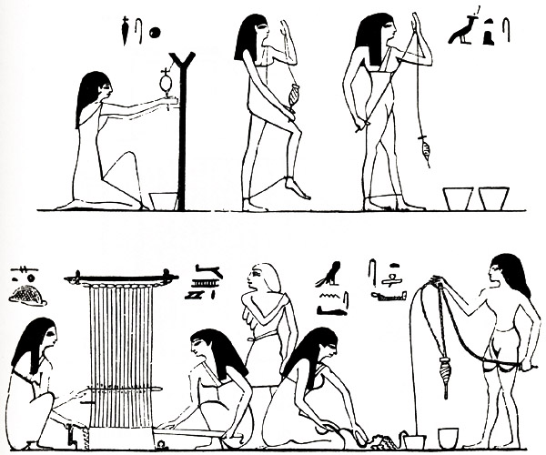
Women weaving and using the spindle
Source: Wilkinson, The Ancient Egyptians.

Slide 34
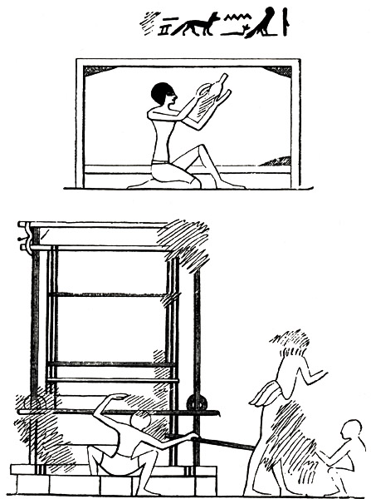
A piece of cloth on a frame (top) a loom (bottom)
Source: Wilkinson, The Ancient Egyptians.

Slide 35
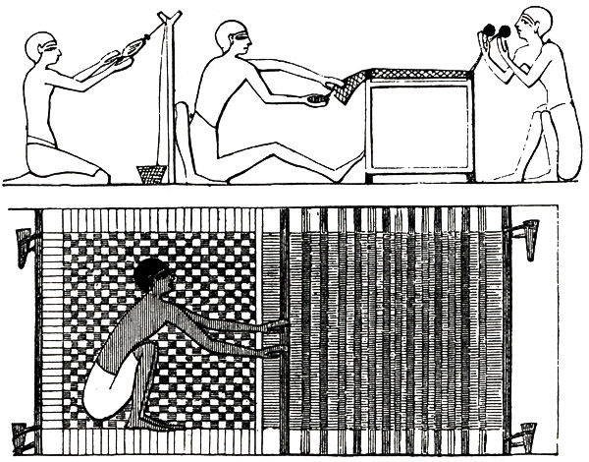
Men engaged in spinning, and making a sort of network (top) The horizontal loom, or perhaps mat-making (bottom)
Source: Wilkinson, The Ancient Egyptians.

Slide 36
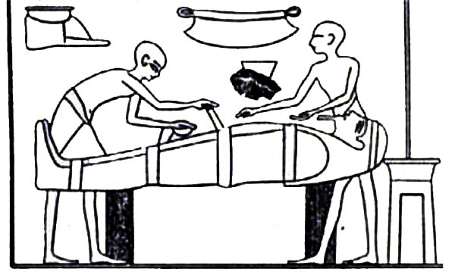
Bandaging Mummies (New Kingdom, Thebes)
The mummification process was a magico-religious act to prepare the body as a fit receptacle for the returning soul.
Decomposition of the fleshy parts were first stopped by (1) removal of brain and abdominal and thoracic viscera, except heart and kidneys, (2) cleaning the viscera with palm-wine and spices, (3) filling the body-cavities with myrrh, cassia, and other aromatic substances, and sewing up the embalming incision, (4) treating the body with natron (sodium carbonate) and washing it, (5) anointing it with cedar-oil and other ointments rubbing it with fragrant materials, and wrapping it in bandages.
Source: Singer et al. 1954. A History of Technology.

Slide 37
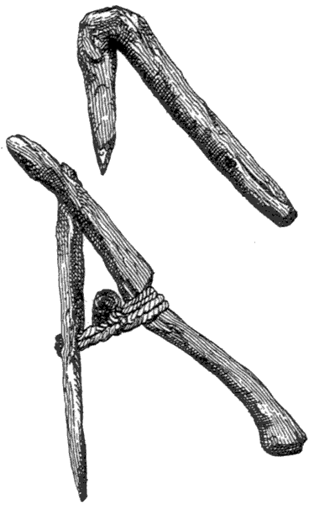
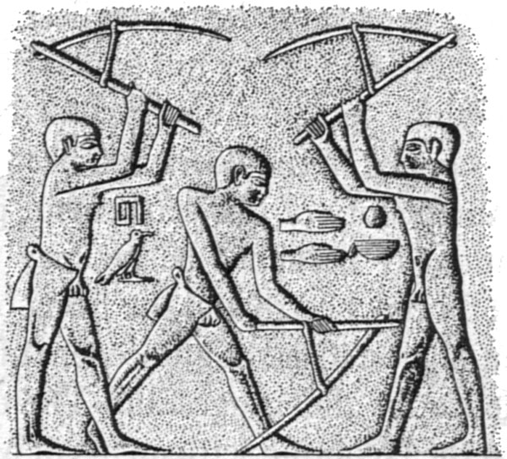
Cultivation Technology
Development of the Hoe
(Top) Primitive hoe cut from a forked branch.
(Bottom) A more developed form with hafted wooden blade. Both Middle Kingdom 2375–1800 BCE).
Soil preparation by hoeing; from a Tomb at Ti at Saqqara, ca. 2400 BCE.
Source: Singer et al., 1954

Slide 38
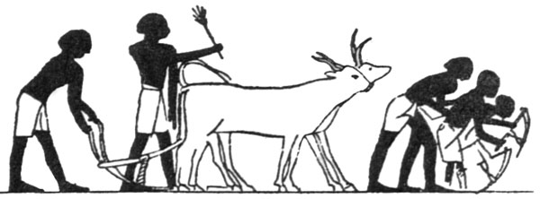
Cultivation Technology
Plowing and Hoeing
from a tomb at Beni Hasan, ca. 1900 BCE
Source: Singer et al., 1954.

Slide 39
Land Reclamation
Trees are being cut in land clearing; clods are broken with mallets, soil is plowed, seed is sown on prepared ground.
Note ladder like cross pieces on plow handle and shaft bound to a double yoke over the oxen horns.
Source: Singer et al., 1954.

Slide 40
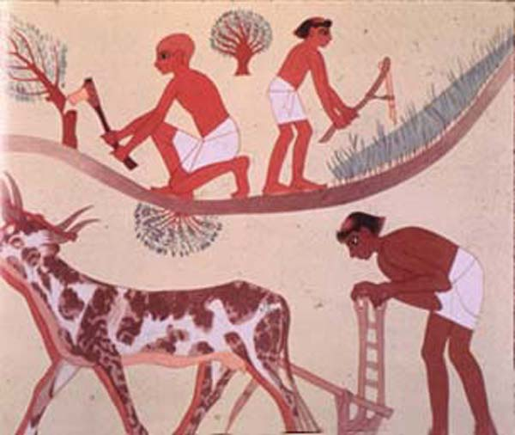
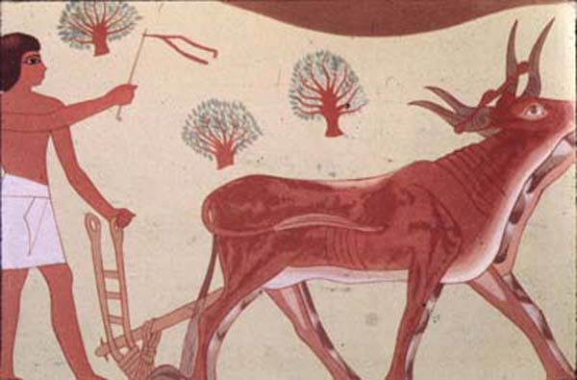
Cultivation, Hoeing, and Plowing
Note ladder like cross pieces on plow handle and shaft bound to a double yoke over the oxen horns.
Source: J. N. Leonard, 1973. The First Farmers.

Slide 41
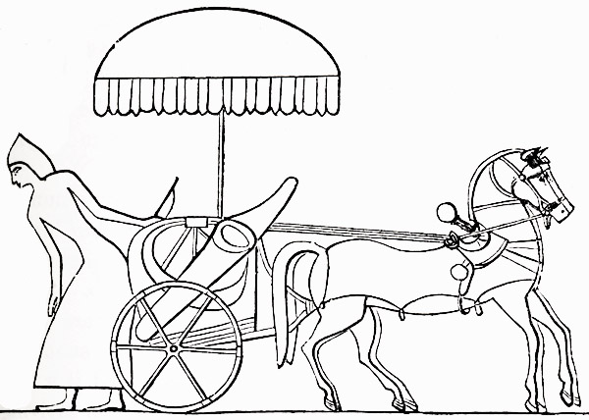
Chariot with Umbrella
Source: Wilkinson, The Ancient Egyptians.

Slide 42
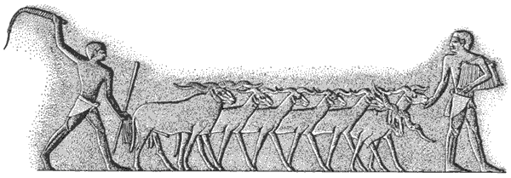
Seeding (Saqqara, ca. 2400 BCE)
Seed is treaded by sheep driven across a field.
The sower offers them a handful of grain to lure them on while another drives them with a whip.
Source: Singer et al., 1954.

Slide 43
They gather in the fruits of the earth with less labor than any other people, … for they have not the toil of breaking up the furrow with the plough, nor of hoeing, nor of any other work which all other men must labor at to obtain a crop of corn; but when the river has come of its own accord and irrigated their fields, and having irrigated them has subsided, then each man sows his own land and turns his swine into it; and when the seed has been trodden into it by the swine he waits for harvest time; then … he gathers in it.

Slide 44
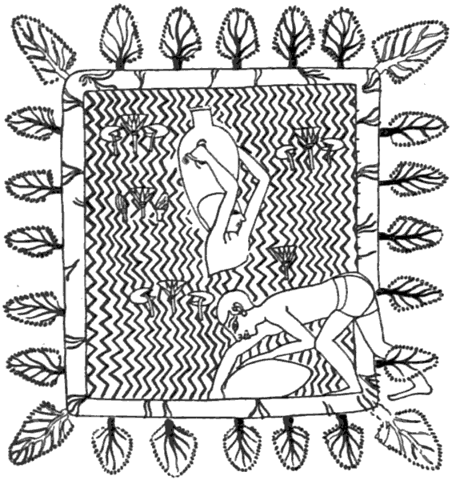
Irrigation Technology (Thebes, ca 1450 BCE)
Drawing water from a lily pond
Source: Singer et al, 1954.

Slide 45
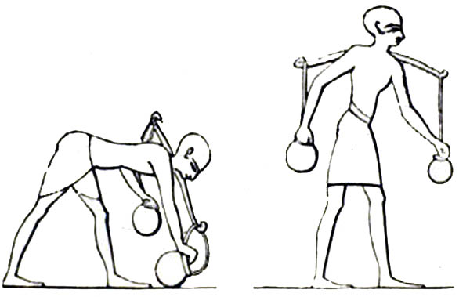
Irrigation Technology: The Yoke

Slide 46
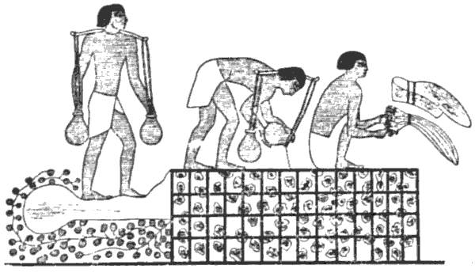
Irrigation Technology (Beni Hasan, ca. 1900 BCE)
Irrigating and harvesting in a vegetable garden.
Gardeners carry pots attached to a yoke and pour water into checkerboard furrows; another ties onions into bundles.
Source: Singer et al., 1954.

Slide 47
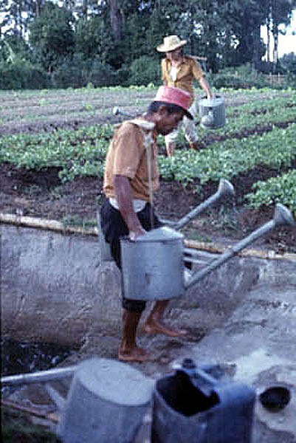
A contemporary scene of garden irrigation in Sumatra. Cabbage is being grown for shipment to Singapore.
Source: J. Janick photo.

Slide 48
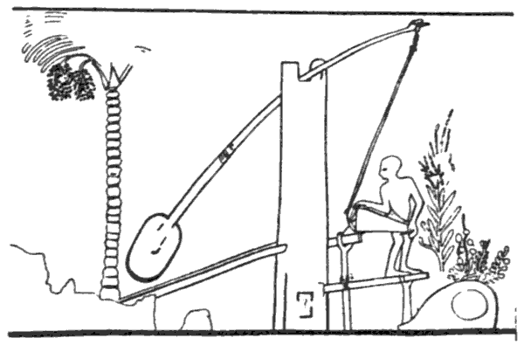
Irrigation Technology: The Shaduf (Thebes ca. 1500 BCE)
Irrigation of a palm orchard by a shaduf, using a water-lifting device consisting of a beam holding a long pole in which a bucket is suspended at one end and a large lump of clay acts as a counterpoise.
The water is funneled to a mud basin at the foot of the palm.
Source: Singer et al., 1954.

Slide 49
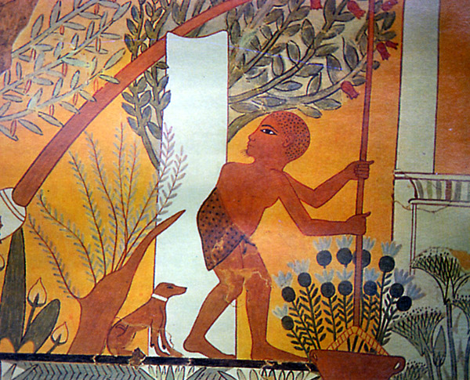
Shaduf (Thebes ca. 1300 BCE)
Irrigation of a garden by means of a row of shadufs.
Lotus grows in the pools and papyrus at their edges.
Source: Singer et al. 1954. A History of Technology.

Slide 50
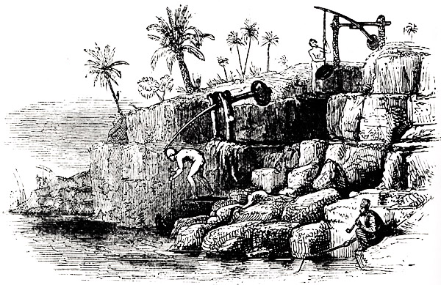
Modern shaduf, or pole and bucket, used for raising water, in Upper and Lower Egypt.
Source: Wilkinson, The Ancient Egyptians.

Slide 51
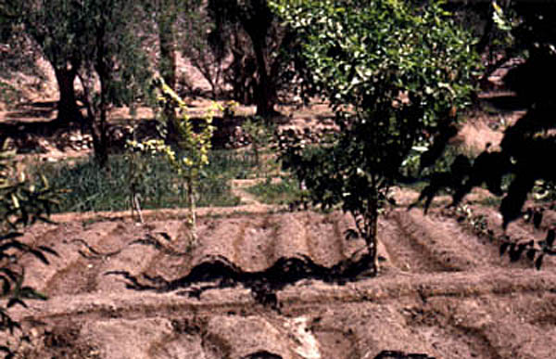
Present day garden at Neve Firan, Sinai showing irrigation channels.
Source: J. Janick photo.

Slide 52
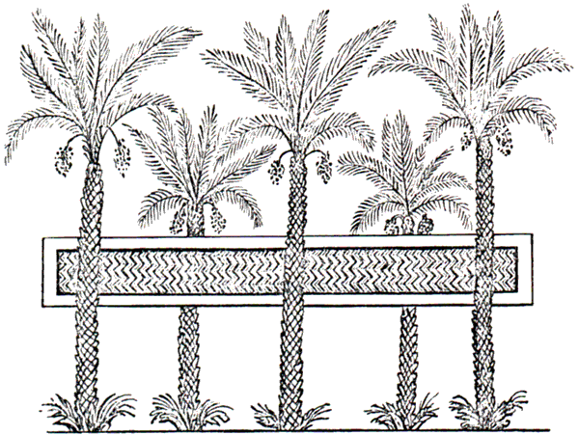
Irrigation Technology: Water Storage
Date palm with water storage pond
in a distorted perspective.
Source: E. Hyams, 1971.

Slide 53
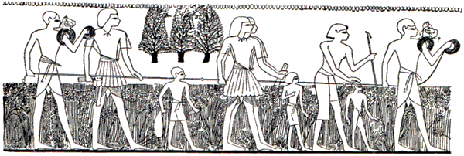
Surveying Fields (Thebes ca. 1400 BCE)
Surveyors measuring a field, probably to determine tax.
Source: Singer et al., 1954.

Slide 54
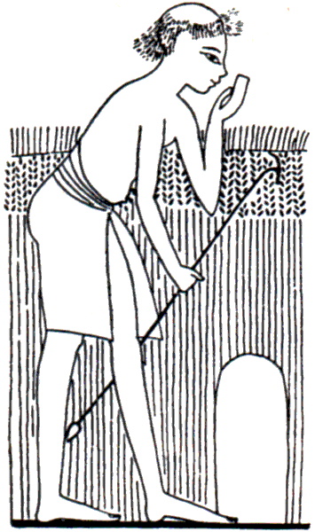
Surveying Fields (ca. 1400 BCE)
Oath taken on a boundary stone:
I swear by the great god that is in heaven that the right boundary stone has been set up.
Source: Singer et al., 1954.

Slide 55
Putting the seed into the basket (left).
Sowing the land after the plow has passed (right).
Note the handle of the plow has a peg at the side like the modern Egyptian plow.
Plowing, sowing, and reaping.
Plucking up the doora by the roots (left).
Reaping wheat (right).
Source: Wilkinson, The Ancient Egyptians.

Slide 56
Harvesting and Handling Grain
Reaping grain and tying sheaves.
Tomb at Mena at Thebes, ca. 1420 BCE.
Source Darby et al., 1976.

Slide 57
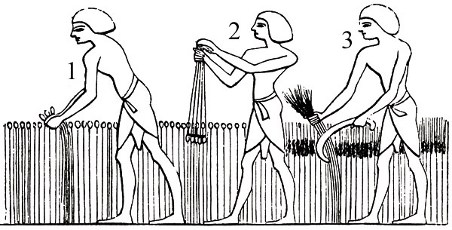
Gathering the doora and wheat
1) Plucking up the plant by the roots
2) Striking off the earth from the roots
3) Reaping wheat
Source: Wilkinson, The Ancient Egyptians.

Slide 58
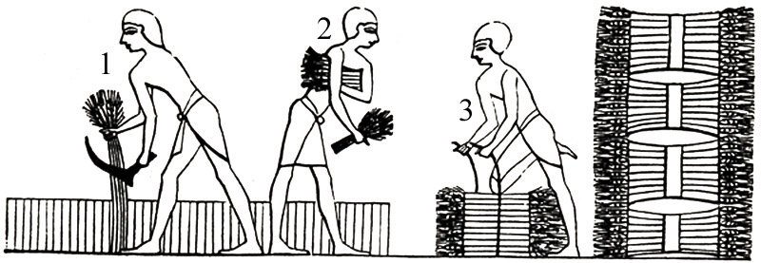
Wheat bound in sheaves
1) Reaping
2) Carrying the ears
3) Binding in sheaves
Source: Wilkinson, The Ancient Egyptians.

Slide 59
Gathering the Doora, and stripping off the grain
1) Woman plucking up the plant by the roots.
2 ) Striking off the earth from the roots after it is plucked up.
3 ) Binding it into a sheaf.
4 ) Carrying it to the area.
5 ) Stripping off the grain by drawing the head forcibly through an instrument furnished with medal spikes for this purpose.
Source: Wilkinson, The Ancient Egyptians.

Slide 60
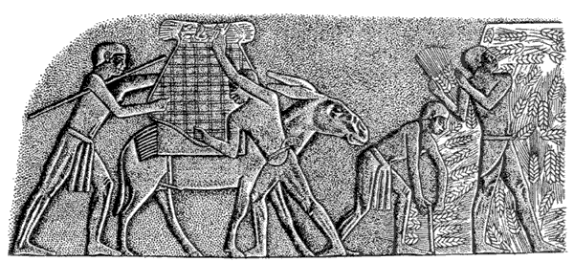
Harvesting and Handling Grain (Saqqara, ca. 2400 BCE)
Harvesting wheat in Old Kingdom.
Heads are bound into sheaves and loaded onto donkeys.
Source: Singer et al. 1954.

Slide 61
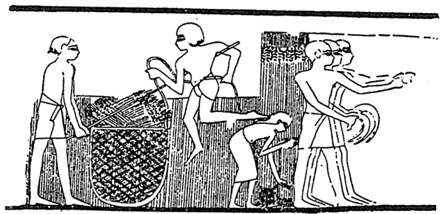
Harvesting and Handling Grain (Thebes ca. 1420 BCE)
Reaping wheat in New Kingdom.
Heads are cut short and cast into a large net.
Source: Singer et al., 1954.

Slide 62
Threshing
1) The steward, or the owner of the land.
2 ) Throws the ears of wheat into the centre, that the oxen may pass over them and tread out the grain.
3 ) The driver.
4 ) Brings the wheat to the threshing-floor in baskets carried on asses.
The oxen are yoked together, that they may walk round regularly.
Source: Wilkinson, The Ancient Egyptians.

Slide 63
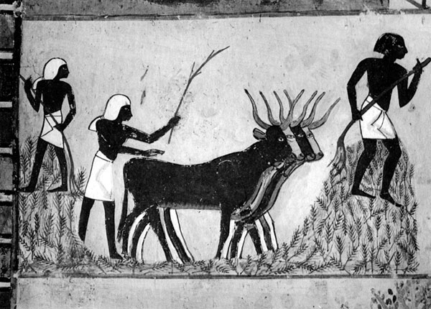
Harvesting and Handling Grain
Oxen threshing grain.
Tomb of Mena at Thebes ca. 1420 BCE.
Source: Darby et al., 1976.

Slide 64
Harvesting and Handling Grain (Thebes ca. 1420 BCE)
(Above) Winnowing grain by tossing the grain into the air with wooden scoops.
(Below) Husked grain is measured in bushels before storage.
Source: Singer et al., 1954.

Slide 65
Harvest Scene
Source: Wilkinson, The Ancient Egyptians.
1) The reapers
2 ) A reaper drinking from a cup
3,4 ) Gleaner: the first of these asks the reaper to allow him to drink.
5 ) Carrying the ears in a rope basket: the length of the stubble showing the ears alone are cut off
8 ) Winnowing
10 ) The tritura, or trodding of grain
12 ) Drinks from a water-skin suspended in a tree
14 ) Scribe who notes down the number of bushels measured from the heap
16 ) Checks the account by noting those taken away to the granary

Slide 66
Rooms for housing the grain, apparently vaulted
Source: Wilkinson, The Ancient Egyptians.

Slide 67
Storing the Harvest and Quality Control
Note scribe and driver with whip
From a tomb at Beni Hasan, Egypt ca. 1900 BCE
Source: Singer et al., 1954.

Slide 68
Storage
Workers carry grain into silos
while scribes register the amount.
Tomb of Antefoker at Thebes, Middle Kingdom.
Source: Darby et al., 1976.

Slide 69
Storage (Beni Hasan, ca. 1900 BCE)
A scribe checks the storing of raisins
Source: Singer et al., 1954.

Slide 70
Processing Grain
Grinding wheat in a saddle-quern
ca. 2500 BCE
A bakery in Rameses III’s tomb at Thebes showing cakes of various shapes
Source: Singer et al. 1954.
Source: Darby et al., 1976.

Slide 71
Harvesting Fruit Crops
Gathering figs in shallow baskets while tame baboons cavort in the tree.
From a tomb at Beni Hasan, Egypt, ca. 1900 BCE.
Source: Singer et al., 1954.

Slide 72
Harvesting Fruit Crops and Flax
A worker harvests pomegranates while a
boy chases away a bird
with a slingshot.
Harvesting and binding
flax in sheaves.
From the tomb of Hetepet, Old Kindom.
Source: Singer et al., 1954.
Source: Hyams, 1971.

Slide 73
Harvesting Fruit from Trellis and Free-standing Trees
Source: Hyams, 1971.

Slide 74
Grape Harvest and Training
The round arbor was a favorite
training system for grapes.

Slide 75
Grape Harvest and Wine Making (Thebes, ca. 1500 BCE)
Grapes are collected from a round arbor and workers crush grapes by stomping while balancing on cords hanging from a frame. Wine is stored in amphorae.
Source: Singer et al., 1954.

Slide 76
Large footpress; the amphorae; and the asp, or Agathodaemon, the protecting deity of the store-room
Source: Wilkinson, The Ancient Egyptians.

Slide 77
Wine Manufacture and Registration
Late Pharaonic–Ptolemaic period, Tomb of Petosiris
Source Darby et al., 1976.

Slide 78
Wine Making: Grape Pressing
Working an Egyptian bag-press.
From a tomb at Saqqara, Egypt ca. 2500 BCE.
Source: Singer et al. 1954. A History of Technology Fig. 186.

Slide 79
Wine Making: Grape Pressing
Early Egyptian bag press where the bag is squeezed by poles.
From a tomb at Saqqara, ca. 2500 BCE.
Source: Darby et al., 1976, Fig. 14.4.

Slide 80
Wine Making: Grape Pressing (Beni Hasan, ca. 1500 BCE)
Expressing juice of grapes by twisting a bag press in which the ends are held apart in a frame.
An inspector tests the cloth for holes.
Source: Darby et al., 1976.

Slide 81
A modern juice extraction machine showing the same principle as the previous figures

Slide 82
A modern continuous cider machine that operates by squeezing fruit in a cloth press

Slide 83
Wine Making
(From a mural in the palace of Thebes of the
reign of Amenopsis II, 1450–1425 BCE)
Preparation of wine showing both
foot pressing and a bag press.
Source: Goor and Nurock, 1968.

Slide 84
Storing Wine
Wine jars found in the tomb of Tut-Ankh-Amon.
The lid bears the stamp of the Pharaoh.
(Right) Note safety opening made in the lid to allow gases out, later closed with a plug of clay.
Source: Darby et al., 1976.

Slide 85
Blending Wines
Mixing wines by siphoning, perhaps at a banquet.
Source: Darby et al., 1976.

Slide 86
Offering wine to a guest
Source: Wilkinson, The Ancient Egyptians.

Slide 87
Men carried home from drinking
Source: Wilkinson, The Ancient Egyptians.

Slide 88
A servant called to support her mistress
Source: Wilkinson, The Ancient Egyptians.

Slide 89
Perfume and Cosmetics
A visual representation of the fragrance from essential oils being extracted from an herb.
Cover of alabaster Canopic Vase in tomb of
Tut-Ankh-Amon.
Note lipstick and painted eyes.
Source: J. Janick photo.

Slide 90
Perfume and Cosmetics
Gathering lilies for their perfume.
Contemporary picture of students harvesting peaches.
Source: Singer et al., 1954, Fig. 189.
Source: R. Hayden photo.

Slide 91
Perfume and Cosmetics
Expressing oil of lily
Source: Singer et al., 1954.

Slide 92
Compounding Ointments and Perfumes (Thebes 1500 BCE)
Assistants crush dried herbs with pestle and mortar (1,2,3,4).
The crushed herbs are added to a bowl of molten fat, stirred (5) and shaped into balls upon cooling (6).
Special jars probably containing spiced wine, a useful solvent because of its alcohol content is siphoned and filtered into a bowl (7).
At extreme left an assistant shapes a piece of wood beneath a bowl heaped with unguents (8).
Source: Singer et al., 1954.

Slide 93
Plant Exploration (ca 2000 BCE)
An epistle in which the Egyptian scribe Sinuhe penned the following description about Yaa, the name for Israel.
It was a goodly land called Yaa Figs were in it and grapes, and its wine was more abundant than its water. Plentiful was its honey, many were its olives; all manner of fruits were upon its trees.
Source: Goor and Nurock, 1968.

Slide 94
Queen Hatshepsut’s Temple (El-Deir El-Bahari)
Hatshepsut, the only woman to rule of Egypt as Pharaoh, names her temple “Djeser, Djeseru,” the Splendor of Splendors.
Source: J. Janick photo.

Slide 95
Close up of Queen Hatshepsut
Note false beard, symbol of Pharaohs
Source: J. Janick photo.

Slide 96
Plant Exploration
Ships of Queen Hatshepsut’s fleet landing at Punt (northeastern coast of Africa) with exotic merchandise for Egypt. Deir el-Bahri, ca. 1500 BCE.
Note tame baboons, marine character of fish, the carting and storage of incense plants.
Source: Singer et al., 1954.

Slide 97
An Early Botanical Collection
Strange plants and seeds brought back from Syria by Thothmes II, as they were carved on the walls of the temple of Karnak, Egypt, ca. 1450 BCE.
Source: Singer et al., 1954.

Slide 98
Oasis at El Tor, Sinai peninsula
Source: J. Janick, photo.

Slide 99
Ancient Egyptian Garden Scenes
Randomly-placed trees within a square enclosure surrounding square pool.
Carving from the tomb of Akhnaton (18th dynasty).
Source: Thacker, 1979.

Slide 100
Ancient Egyptian Garden Scenes
Four workers transporting trees.
Tree with earth raised around the roots.
Source: Wright, 1934.
Source: Wilkinson, The Ancient Egyptians.

Slide 101
Ancient Egyptian Garden Scenes
Harvesting pomegranates in formal planting interspersed with ornamental columns next to a T-shaped pool.
Source: Hyams, 1971.

Slide 102
Ancient Egyptian Garden Scenes (Thebes, ca. 1300 BCE)
Garden planted with fig, olive trees and flowering plants containing a pavilion with steps leading down to the water, being irrigated by a row of shadufs.
Source: Singer et al., 1954.

Slide 103
Formal Egyptian garden (Thebes ca. 1450 BCE)
The lotus pool, on which statue of the vizier Rekhmire is being towed by boat, faces a pavilion or summerhouse.
Around the pool grow doum palms, date palms, acacias, and other trees and shrubs.
Source: Singer et al., 1954.

Slide 104
A late 19th century impression (1883) of a bird’s eye view of a high official’s garden
Source: J. S. Berrall, The Garden: An Illustrated History.

Slide 105
A Complete Egyptian Temple
Source: Wilkinson, The Ancient Egyptians.

Slide 106
Garden Plan for a Wealthy Egyptian Estate
Note two types of palms: single trunk = date palm, bifurcated trunk = doum palm.
Source: Berrall, 1966.

Slide 107
Tomb painting of an Egyptian garden
Source: The Gardens of Pompeii, Jashemski, 1979.

Slide 108
Villa, with obelisks and towers, like a temple
Source: Wilkinson, The Ancient Egyptians.

Slide 109
A noble couple, surrounded by farm scenes give thanks for the harvest by anointing an array of fruit, vegetables, bread, and meat.
Source: J. N. Leonard, 1973. The First Farmers.

