Slide 1
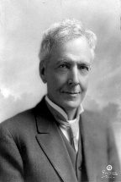
Workshop: History of Horticultural Science Working Group
Contributions of Luther Burbank: Plant Breeding Artist and Legend

Slide 2
Contributions of Luther Burbank: Plant Breeding Artist and Legend
The objectives of this workshop are to:
1. Honor Luther Burbank, legendary plant breeder and horticulturist.
2. Examine the contributions and present fate of Luther Burbank’s creations.
3. Emphasize the role of artistry and horticulture in plant breeding.

Slide 3
1:45–2:05 Luther Burbank: Plant Breeding Artist, Horticulturist, and Legend Jules Janick
2:05–2:20 Russet Burbank: No Ordinary Potato Charles R. Brown
2:20–2:35 A Vast Array of Beauty: The Accomplishments of the Father of American Ornamental Plant Breeding, Luther Burbank Neil O. Anderson, Richard T. Olsen
2:35–2:50 Luther Burbank’s Plums David A. Karp
2:50–3:05 21st Century Approach to Improving Burbank’s ‘Stoneless’ Plum Ann Callahan, Chris Dardick, Ralph Scorza
3:05–3:20 Luther Burbank’s Contributions to Walnuts John Preece, Gale H. McGranahan
3:20–3:35 Luther Burbank’s Berries Kim E. Hummer, Chad E. Finn, Michael Dosett
3:35-3:45 Discussion

Slide 4
Luther Burbank: Plant Breeding Artist, Horticulturalist, and Legend
Jules Janick
Department of Horticulture & Landscape Architecture
Purdue University
West Lafayette, Indiana 47907 www.hort.purdue.edu/newcrop
Notes:
It is a pleasured to be here in Providence at this celebration of the ASHS Centennial. I have been a member of ASHS for 51 years, and I am proud to be affiliated with this venerable Society. Now, 100 Years is a long time but yet I feel a connection to 1903. When I was a student at Cornell University Liberty Hyde Bailey was brought in to speak to my Vegetable Crops class, taught by Bob Sweet. Think of it; Bailey was born in 1858. The mystic chords of memory will be stretched today.

Slide 5
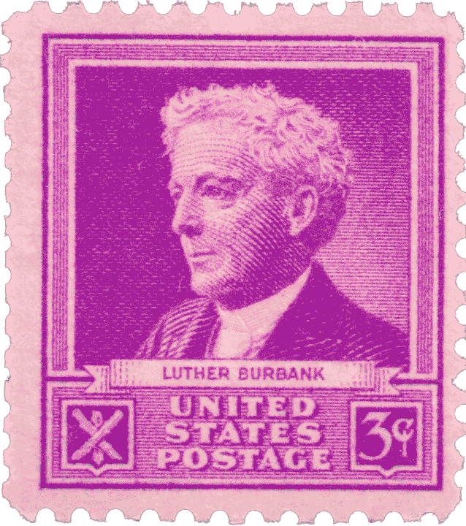
1940 Famous Americans Series

Slide 6
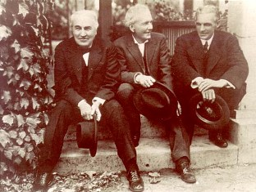
Thomas Edison, Luther Burbank, and Henry Ford 1915

Slide 7
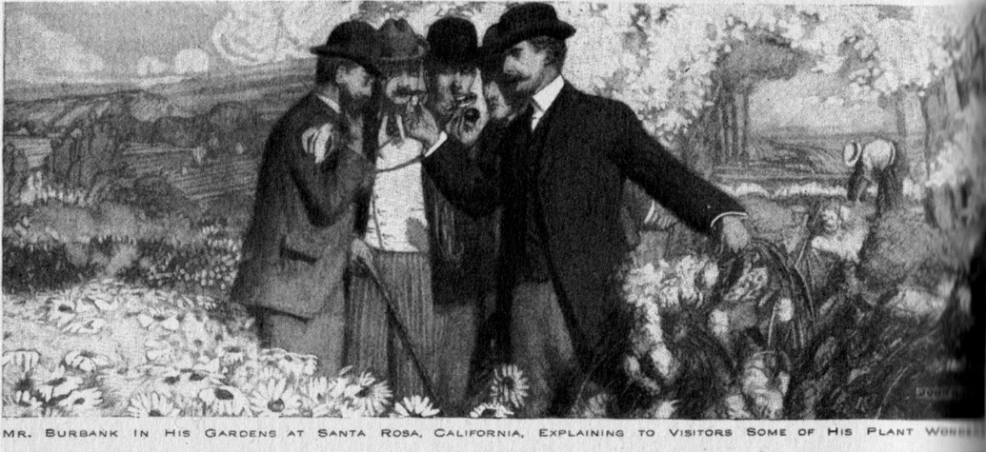
Luther Burbank: The High Priest of Horticulture who has worked marvels in transforming and improving plant life and products. Cover of Success Magazine, July 1905

Slide 8
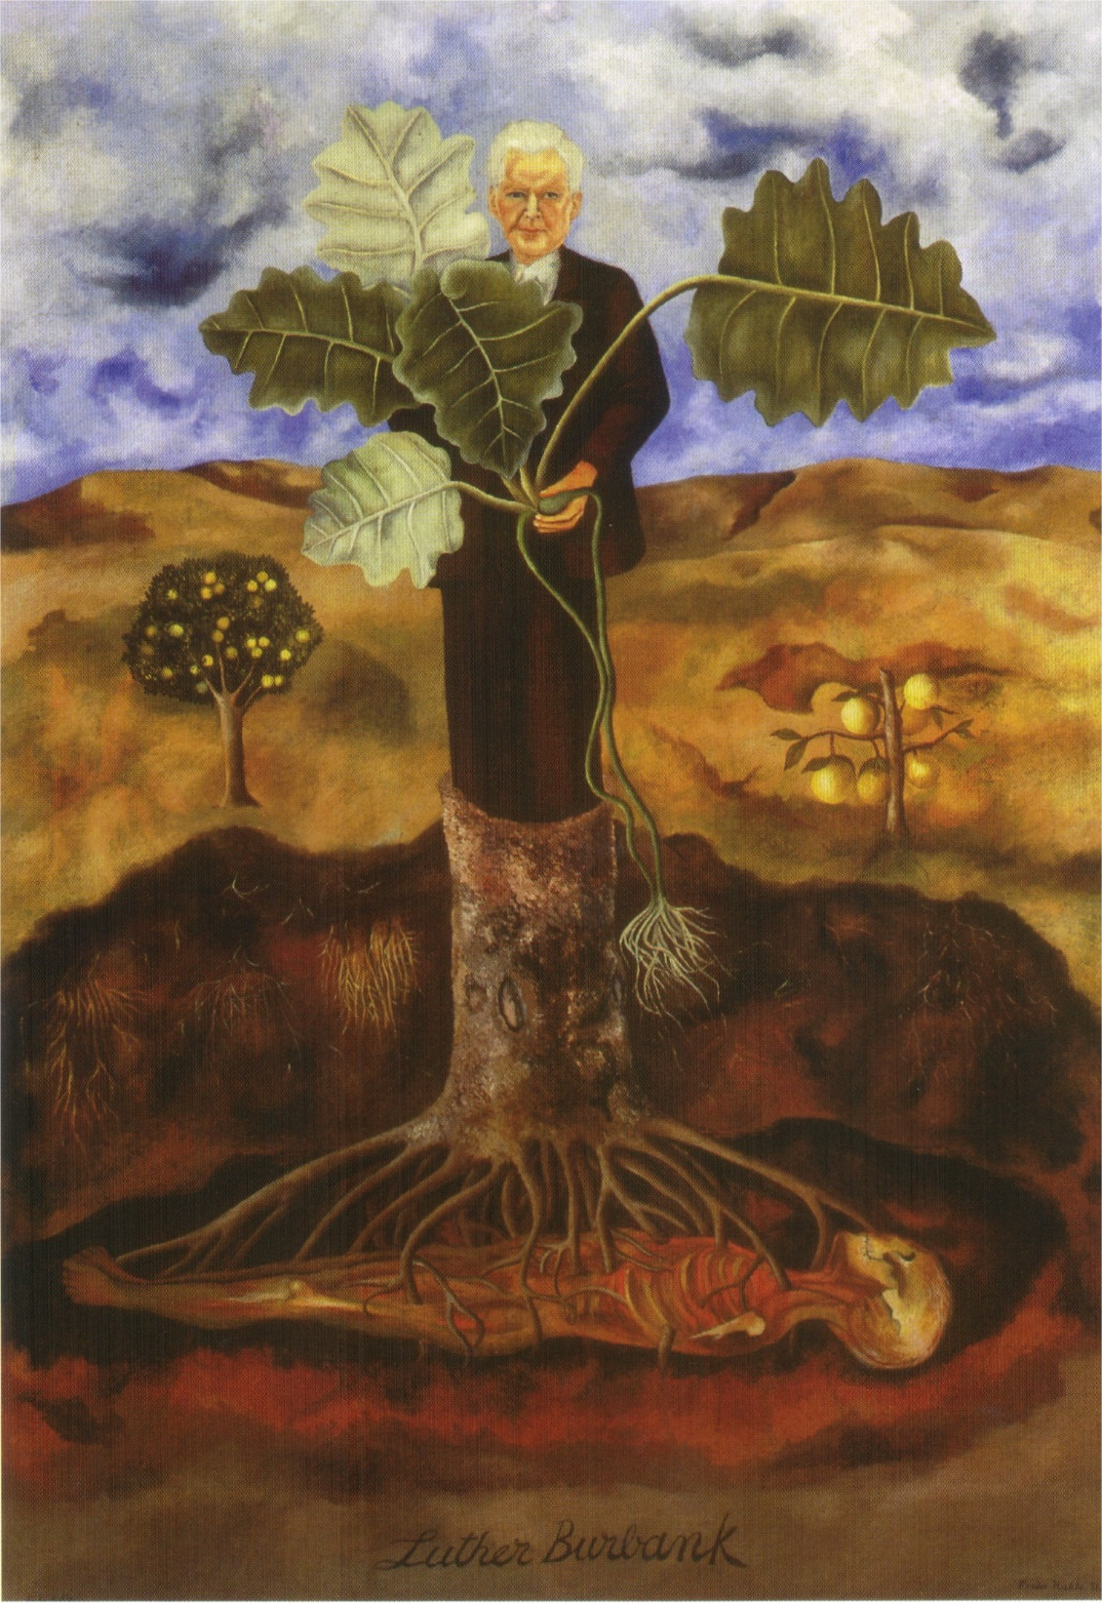
Freda Kahlo, 1931

Slide 9
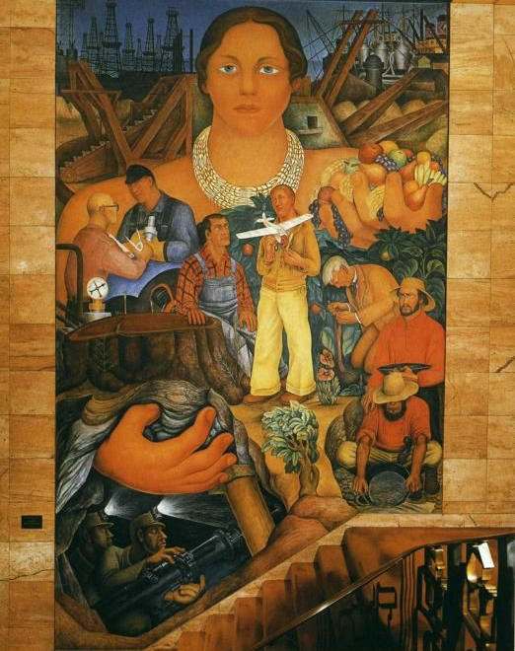
Diego Rivera Allegory of California 1930–1931 Mural on wall and ceiling at Pacific Stock Exchange Tower, San Francisco

Slide 10
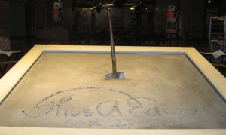
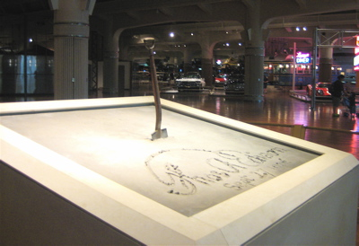
Burbank’s garden shovel, 1928, Ford Museum
Thomas Edison planted Burbank’s garden shovel in Ford’s museum, thrusting it into the new cement at a 1928 groundbreaking ceremony witnessed by an international crowd of celebrities and dignitaries. As the accompanying sign reports, “Edison’s act set in motion Henry Ford’s vision to honor the common genius of the American people.”

Slide 11
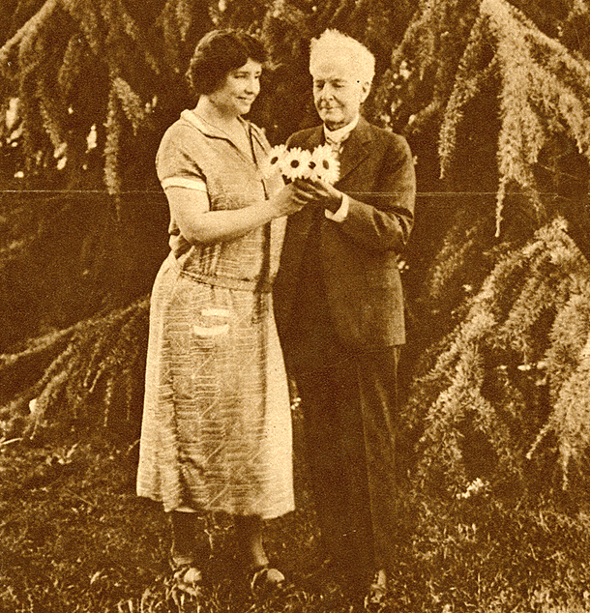
Helen Keller and Luther Burbank, 1925

Slide 12
Burbank Received Several Hundred Awards
Diploma issued by the Lewis & Clark Exposition to a grower for the Burbank Crimson Winter Rhubarb
Wilder medal (American Pomological Society)
Gravenstein Apple Show Association
California Academy of Science
Pan American Exposition
California State Agricultural Society
California State Floral Society
ASHS Hall of Fame 1991
Notes:
Received more than several hundred medals

Slide 13
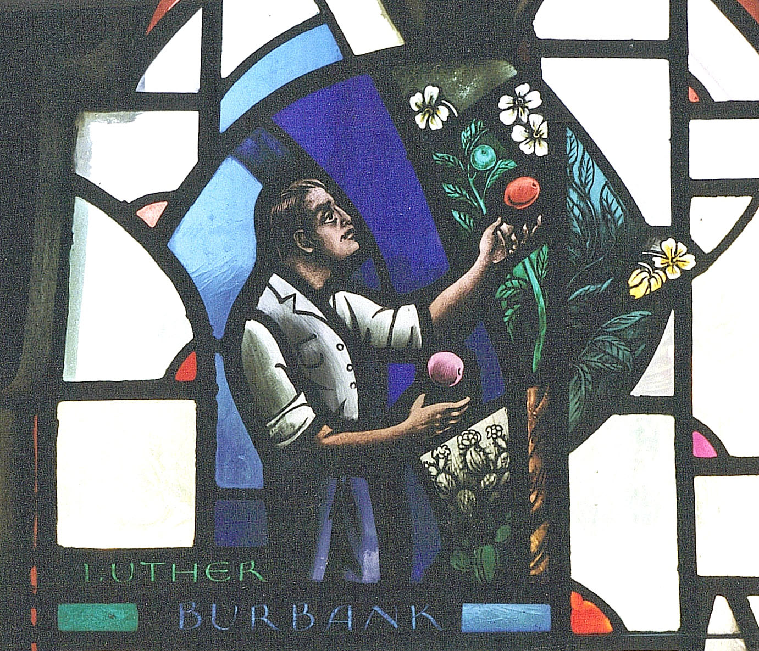
Grace Cathedral, San Francisco
All Saints Episcopal Church, Detroit

Slide 14
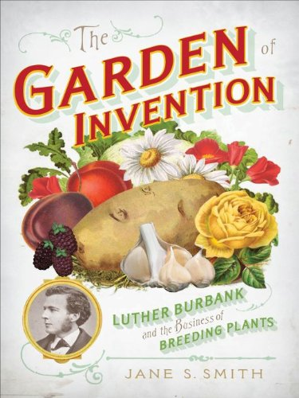
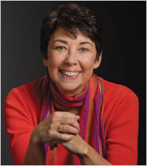
Jane S. Smith
2009

Slide 15
Burbank’s Childhood Home Lancaster, Massachusetts
Notes:
Burbank homestead at Lancaster, Massachusetts

Slide 16
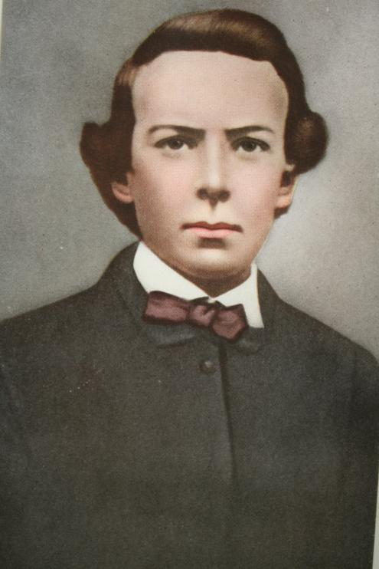
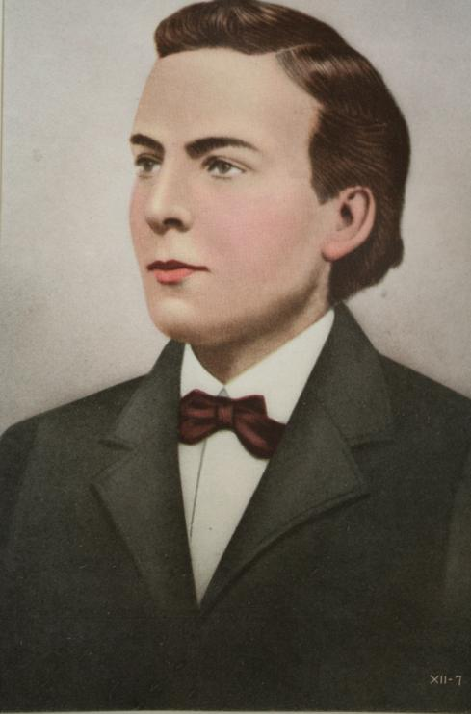
Burbank Grows up 9, 14, 17
Notes:
Olive had borne 2 children before Luther – both died in infancy.
Two children followed Luther. Burbank grew up as the “elder” of the set of 3 children.

Slide 17
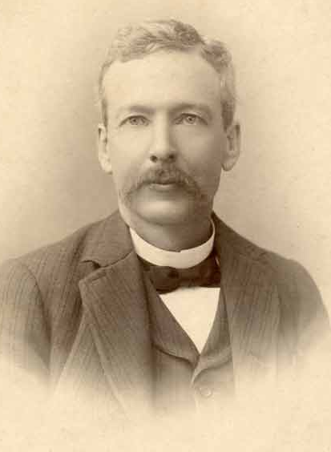
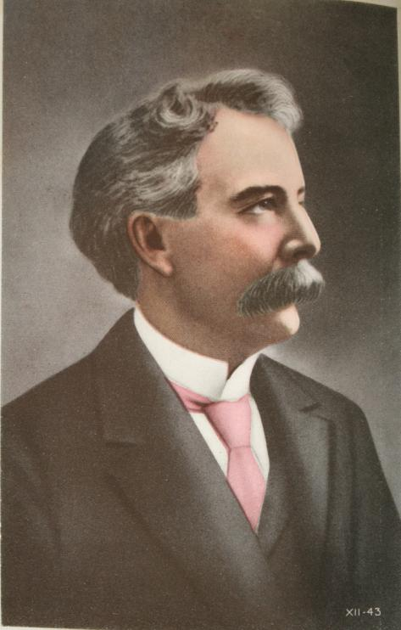
Notes:
At 25 he had his first success with the release of the Burbank Potato
Following year 1825 he migrated to California to take up residence in Santa Rosa

Slide 18
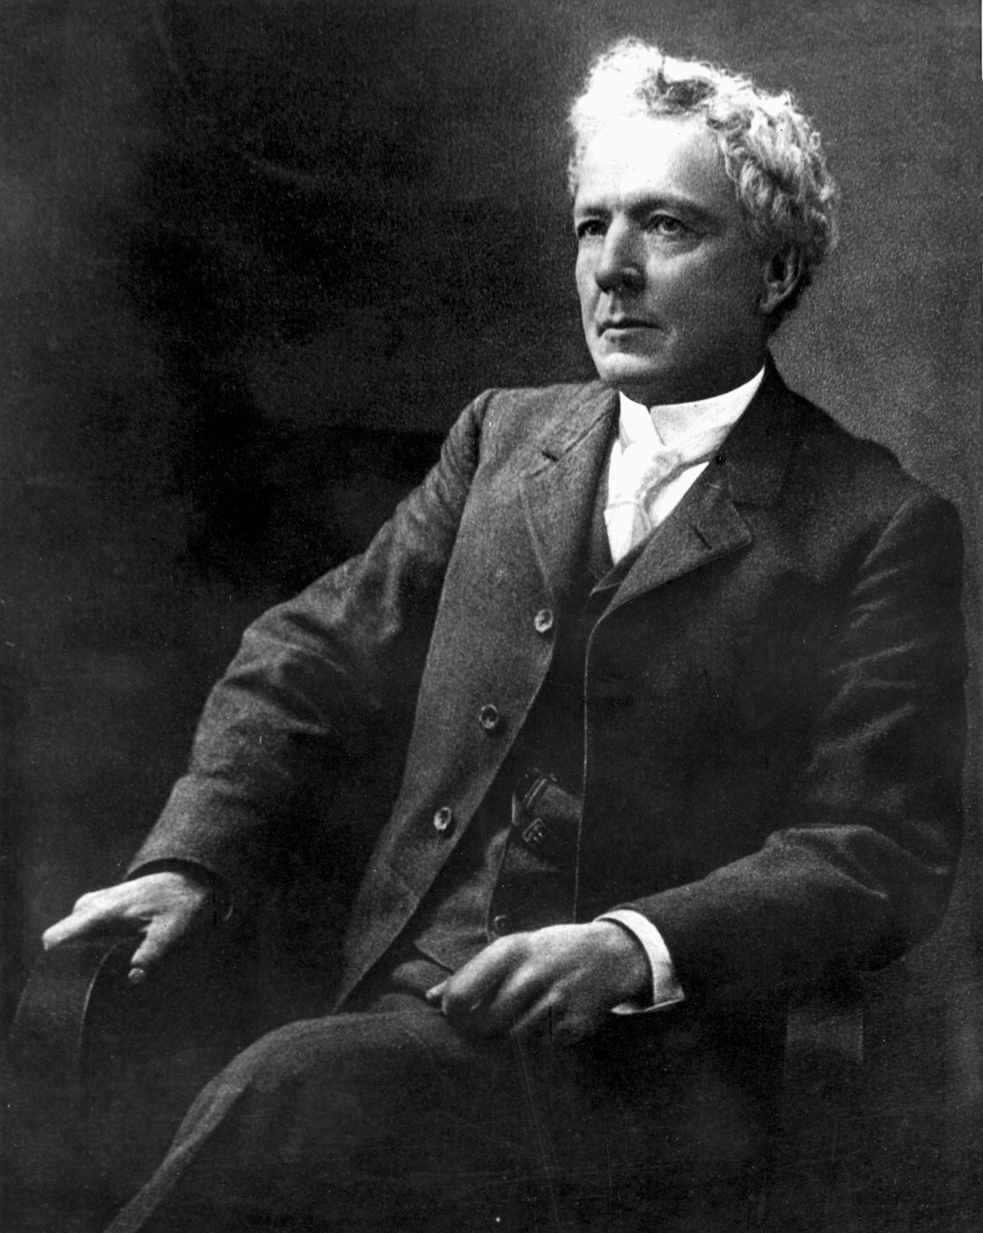

Slide 19
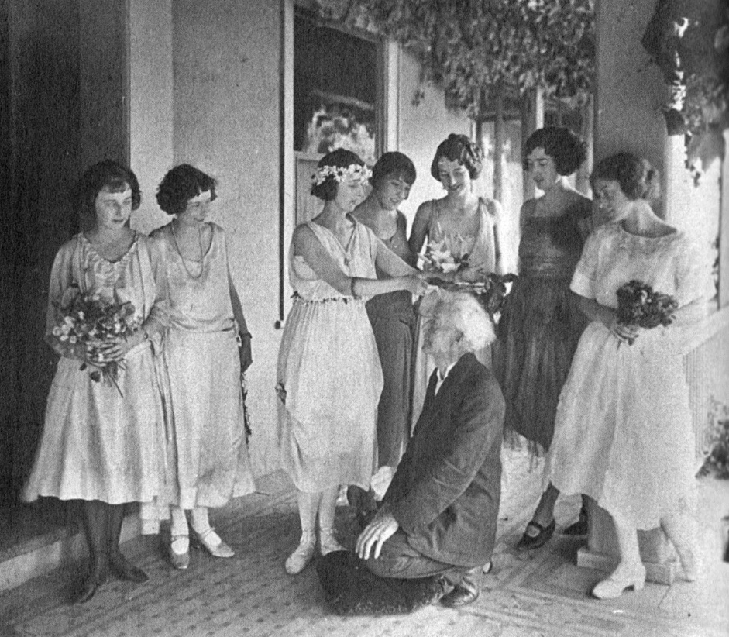
Burbank Golden Jubilee Celebration 1923

Slide 20
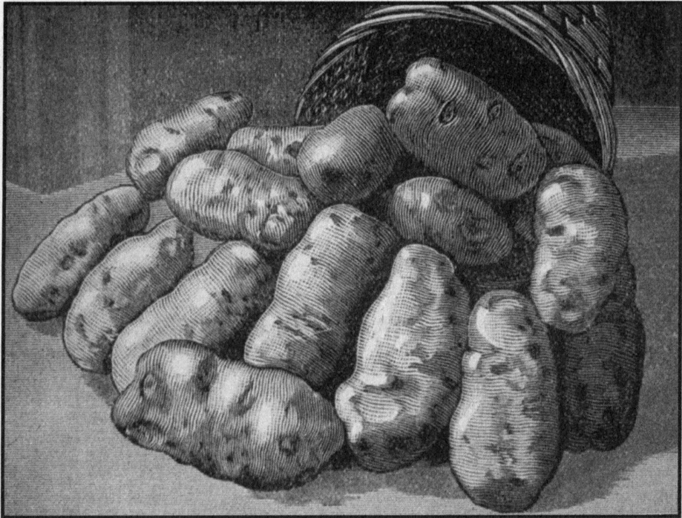
Burbank seedling #15, 1873

Slide 21
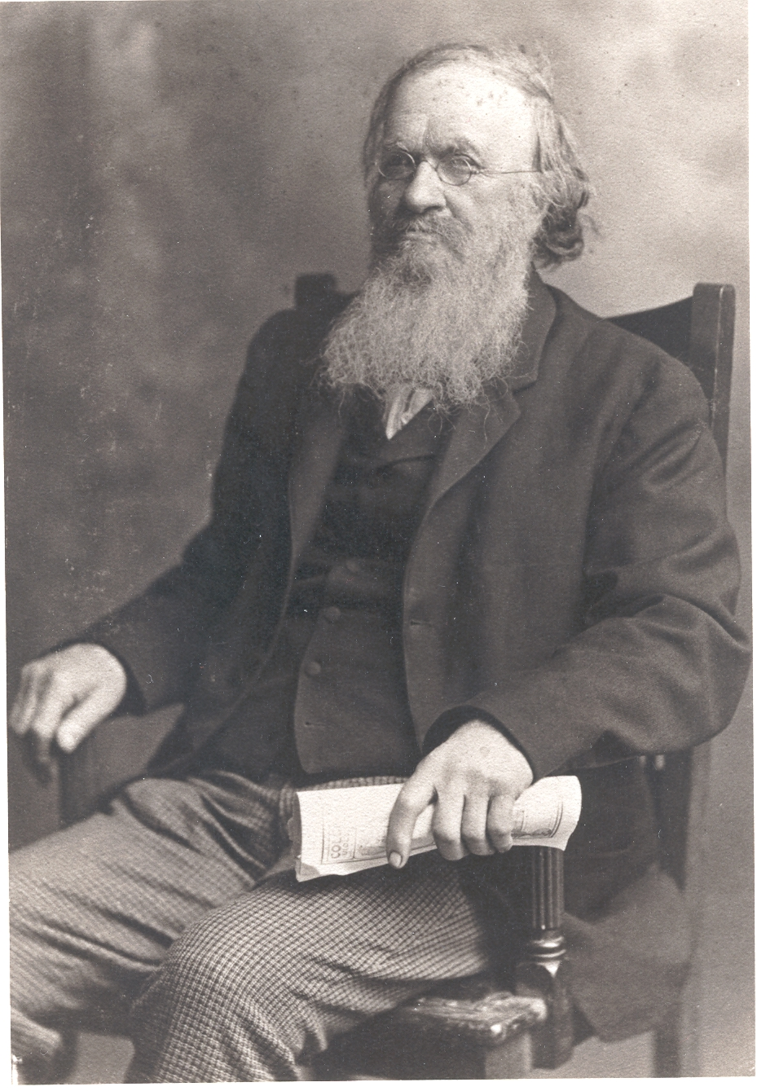
James J.H. Gregory, Purchaser of the Burbank Potato ($150)
Notes:
Burbank used the money to fund his moving to California

Slide 22
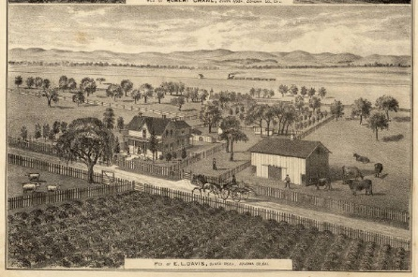
Santa Rosa, California

Slide 23
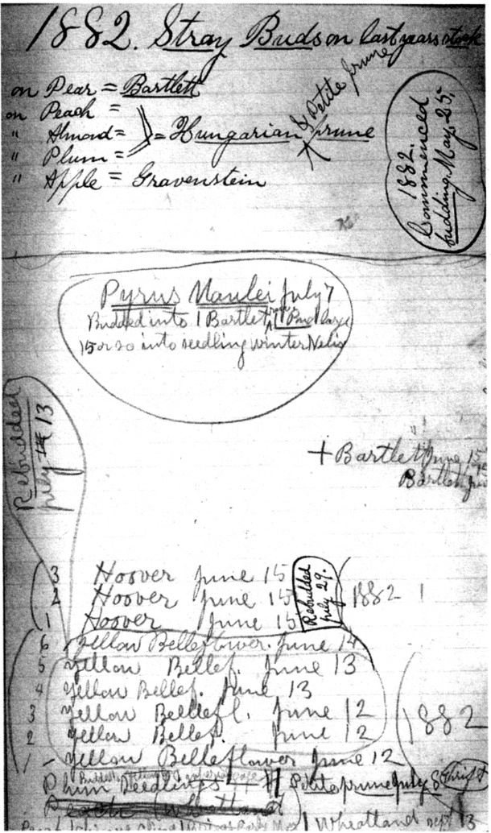
Burbank Nursery Plan Book 1881–1882

Slide 24
Burbank’s first advertisement

Slide 25
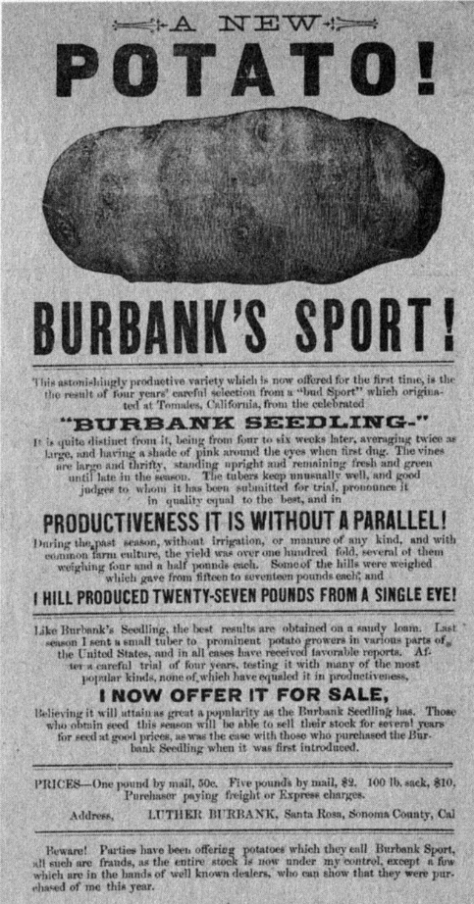
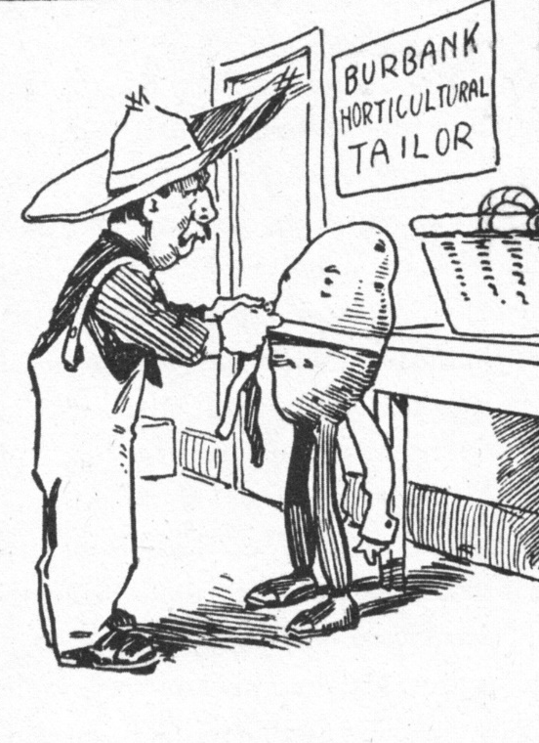

Slide 26
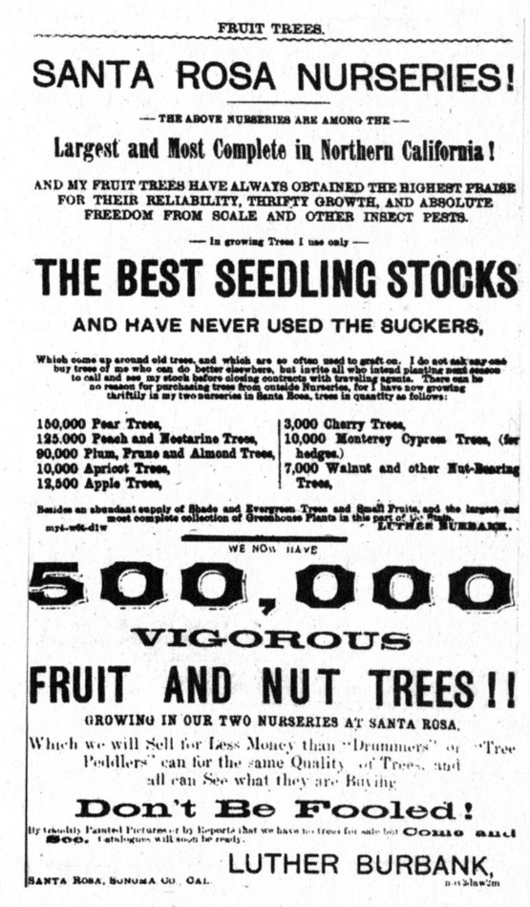
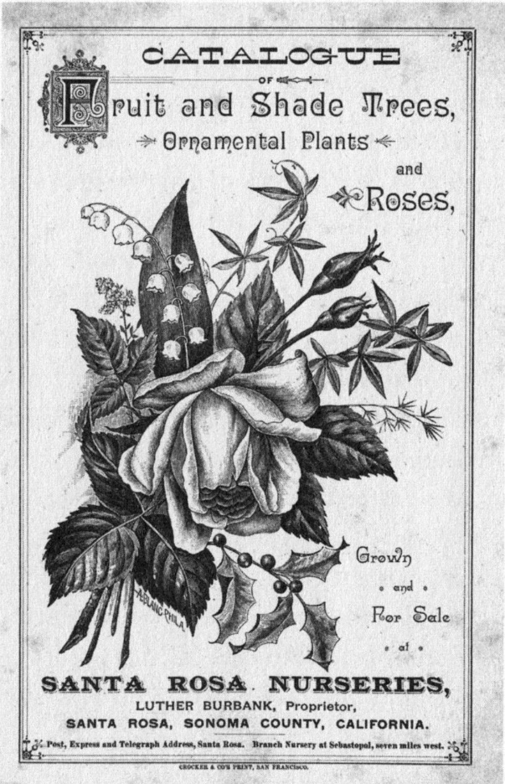

Slide 27
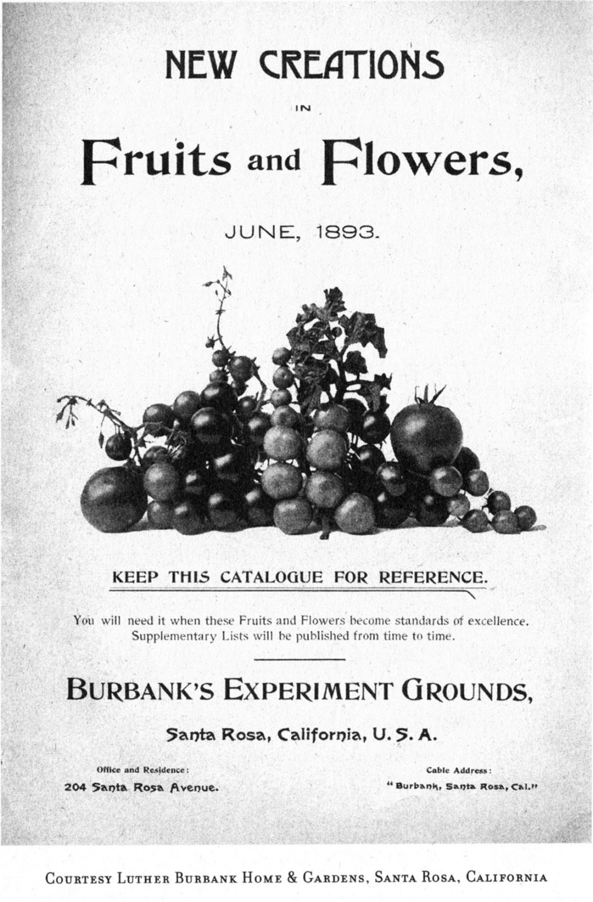
1893

Slide 28
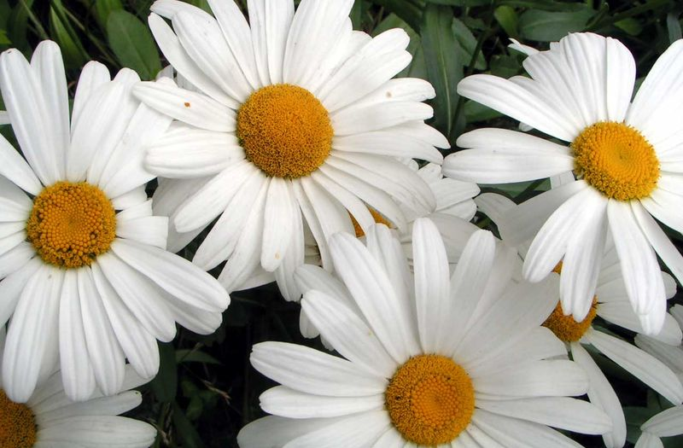

Slide 29
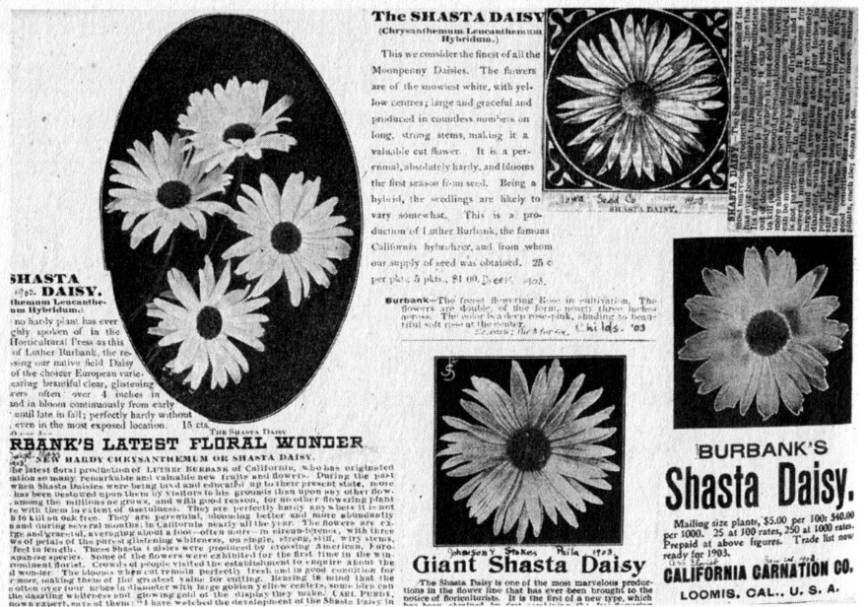

Slide 30
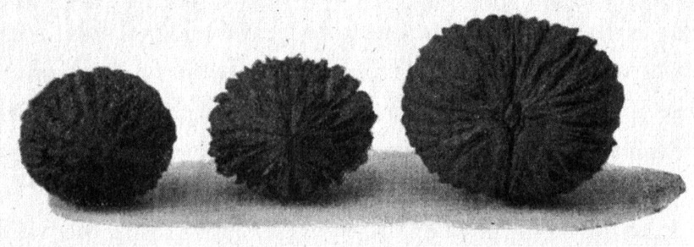
Hybrid Walnut
Juglans californica Staminate parent
Juglans nigra Pistillate parent
Hybrid Walnut

Slide 31
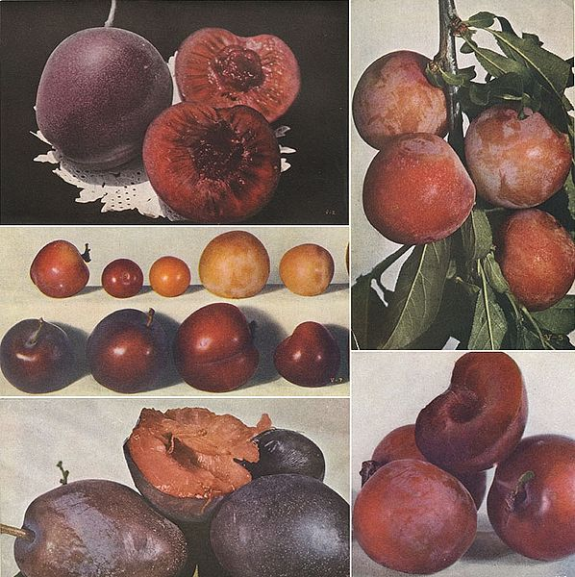
Satsuma Plums

Slide 32
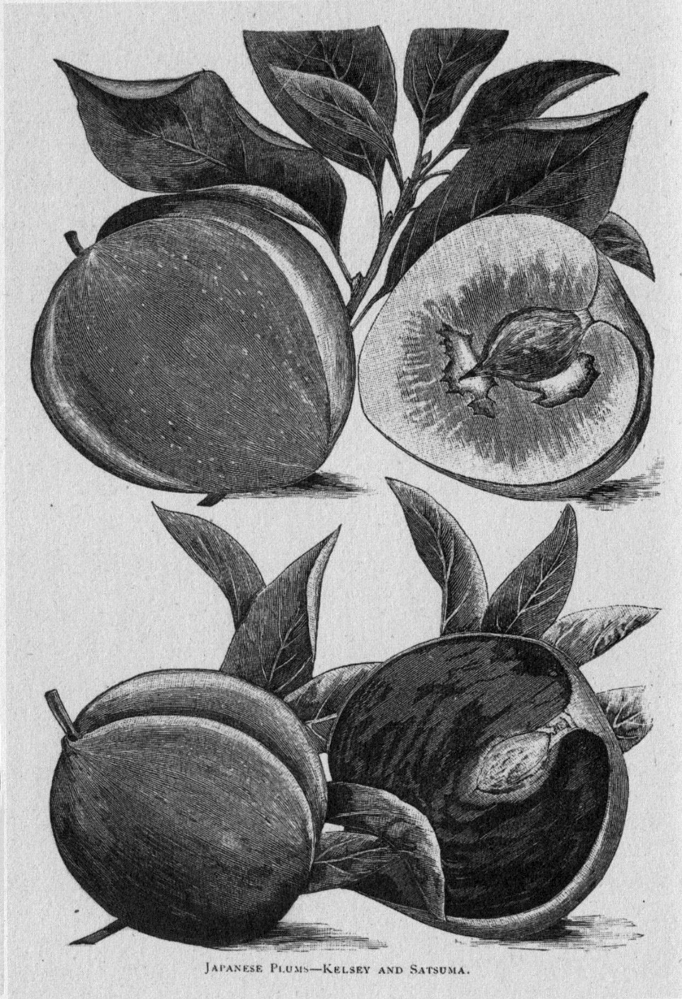
Japanese Plum Kelsey and Satsuma

Slide 33
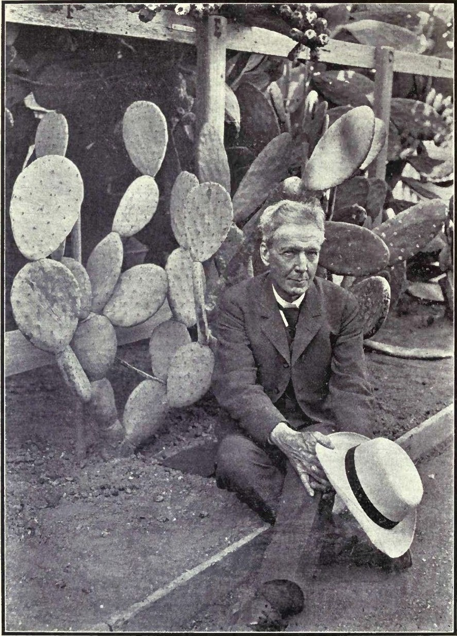
Thornless Cactus

Slide 34
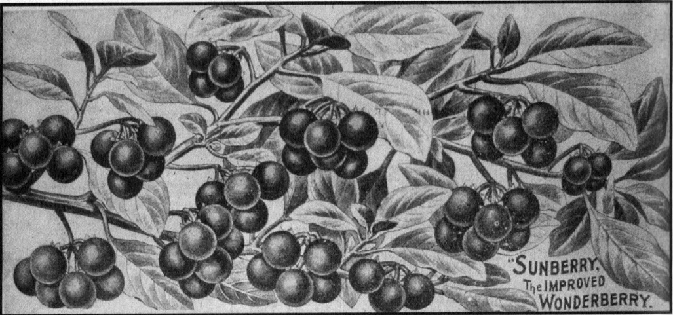
Sunberry (Wonderberry), Solanum hybrid

Slide 35
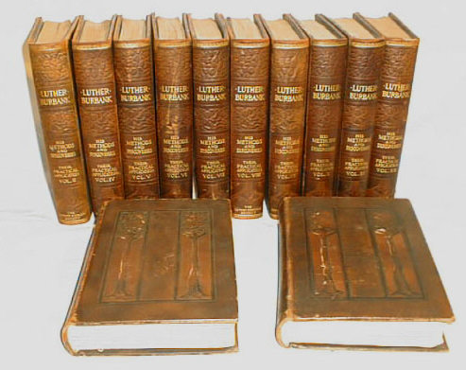
Luther Burbank: His Methods and Discoveries 1914–1915

Slide 36
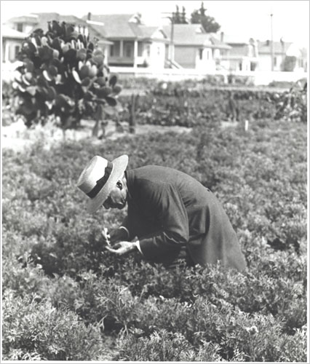
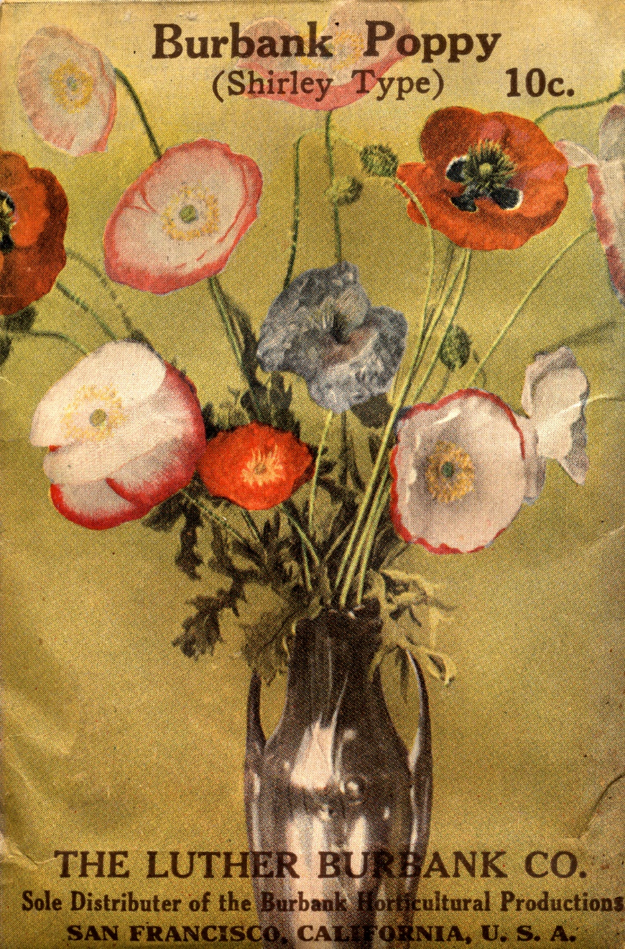

Slide 37
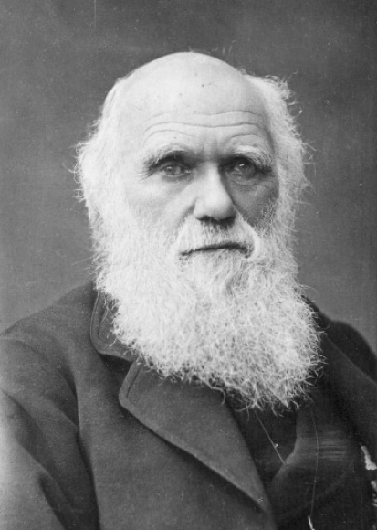
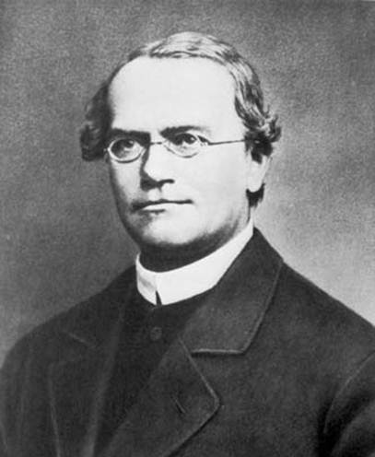
Charles Darwin
Gregor Mendel
The Variation of Animals and Plants under Domestication, 1868

Slide 38
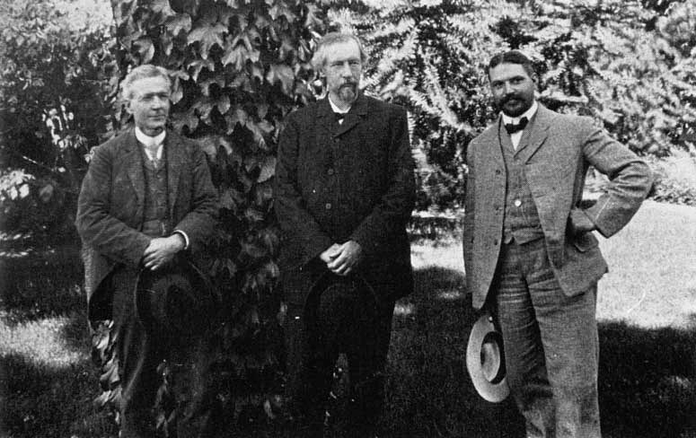
Burbank, Hugo de Vries, George Shull, 1907

Slide 39
Burbank Quotes
The scientist is a lover of truth for the very love of truth itself, wherever it may lead.
Every normal being has ideals, one or many, to look up to, to reach up to, to grow up to.

Slide 40
Religion refers to the sentiments and feelings; science refers to the demonstrated everyday laws of nature.
Feelings are all right, if one does not get drunk on them.
Those who take refuge behind theological barbed wire fences, quite often wish they could have more freedom of thought, but fear the change to the great ocean of scientific truth as they would a cold bath plunge.
I do not believe what has been served me to believe. I am a doubter, a questioner, a skeptic. When it can be proved to me that there is immortality, that there is resurrection beyond the gates of death, then will I believe. Until then no.

Slide 41
A man can patent a mousetrap or copyright a nasty song, but if he gives to the world a new fruit that will add millions to the value of earth’s annual harvests, he will be fortunate if he is rewarded by so much as having his name connected with the result.

Slide 42
Burbank potato | 1873 | Miracle (stoneless) plum | 1901 | Black Giant cherry | 1911
Himalaya blackberry | 1885 | Shasta daily |  | Rainbow corn
Satsuma plum | 1886 | Burbank cherry | 1903 | Santa Rosa artichoke
Paradox walnut | 1893 | Santa Rosa dahlia |  | Hybrid sunflowers | 1914
Royal walnut |  | Burbank Crimson California poppy | 1904 | New Burbank Early tomato | 1915
Van Deman quince |  | Santa Rosa Shirley poppies |  | Sunrise daylily | 1917
Lemon Giant calla lily |  | Rutland plumcot | 1905 | Elephant garlic | 1919
Iceberg white blackberry | 1894 | Burbank’s Giant Hybrid amaryllis | 1906 | Robusta strawberry | 1920
Wickson plum |  | Santa Rosa plum |  | Sebastopol thornless blackberry
Tarrytown canna lily | 1895 | Spineless cacti | 1907 | Molten Fire amaranthus | 1922
Burbank rose | 1899 | Burbank Admiral pea | 1908 | Tower of Gold knophoria (poker plant) | 1923
New gladiolus hybrids |  | America Admiral pea |  | Burbank Giant Dahlia zinnia | 1935
White agapanthus |  | Sunberry (Wonderberry) | 1909 | Gold nectarine | 1927 (posth.)
Crimson Winter rhubarb | 1900 | America Evening primrose | 1910 | July Elberta peach | 1932 (posth.)

Slide 43
Burbank the Horticulturist
He was a successful nurseryman and promoter who had a lasting influence on US horticulture.
He has become the most prominent horticulturist in the United States and became a legend in his lifetime.
He established the concept that plant breeding could be a profitable business.
He was instrumental in getting the 1930 plant patent laws enacted although he did not live to see his triumph.
Burbank still remains the best know US horticulturist.

Slide 44
Burbank the Plant Breeder
Burbank was not a scientist in the modern sense.
He did not understand genetics or the scientific method.
He was a successful plant breeder with 800 creations many of lasting value.
He was a believer in Darwin and evolution and was instinctively correct in his breeding methods exploiting diverse germplasm, wide crosses, continual backcrosses, and continual selection.
He demonstrated that certain hybrids could breed true, unwittingly demonstrating allopolyploidy.
His notes were shoddy, but he knew his plant material.
He was truly the plant breeding artist.

Slide 46
1:45–2:05 Luther Burbank: Plant Breeding Artist, Horticulturist, and Legend Jules Janick
2:05–2:20 Russet Burbank: No Ordinary Potato Charles R. Brown
2:20–2:35 A Vast Array of Beauty: The Accomplishments of the Father of American Ornamental Plant Breeding, Luther Burbank Neil O. Anderson, Richard T. Olsen
2:35–2:50 Luther Burbank’s Plums David A. Karp
2:50–3:05 21st Century Approach to Improving Burbank’s ‘Stoneless’ Plum Ann Callahan, Chris Dardick, Ralph Scorza
3:05–3:20 Luther Burbank’s Contributions to Walnuts John Preece, Gale H. McGranahan
3:20–3:35 Luther Burbank’s Berries Kim E. Hummer, Chad E. Finn, Michael Dosett
3:35-3:45 Discussion

